Slide 1
Lab meeting
Nov 12, 2015

Slide 2
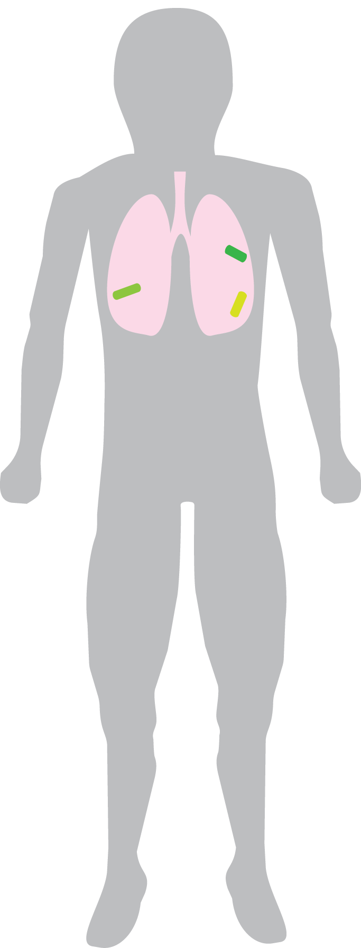


Thinking about how someone gets infected…
M. tuberculosis
Host

Slide 3

How do bacteria establish infection?

Slide 4
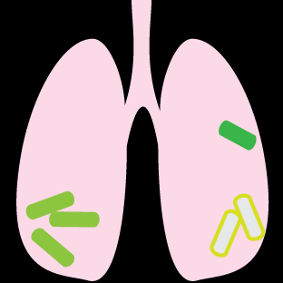
How do bacteria establish infection?
Which bacteria live and die?

Slide 5
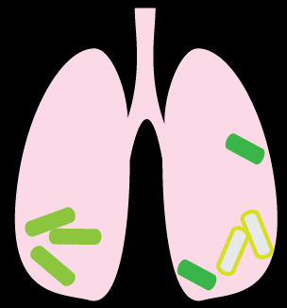
How do bacteria establish infection?
Which bacteria live and die?
Which bacteria disseminate?

Slide 6
…How do we track bacteria during infection?

Slide 7
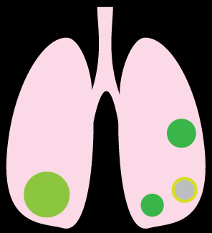
M. tuberculosis form lesions called granulomas during infection

Slide 8
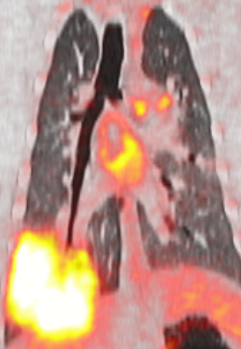
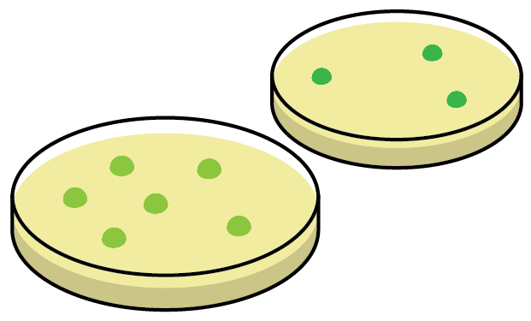
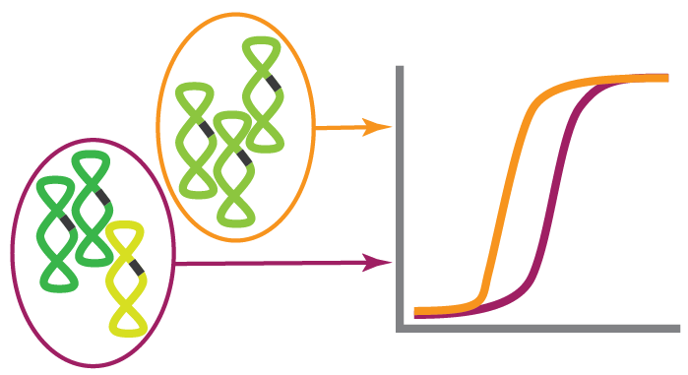
Track lesions by PET
Count CFU of plated lesions
Quantify CEQ in homogenates
Image: Anthony Cadena,
U. Pittsburgh

Slide 9
Barcode Tracking
Track lesions by PET
Count CFU of plated lesions
Quantify CEQ in homogenates
Image: Anthony Cadena,
U. Pittsburgh

Slide 10
What is Barcode Tracking?

Slide 11

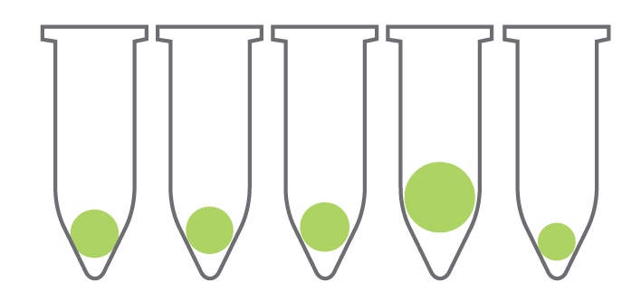

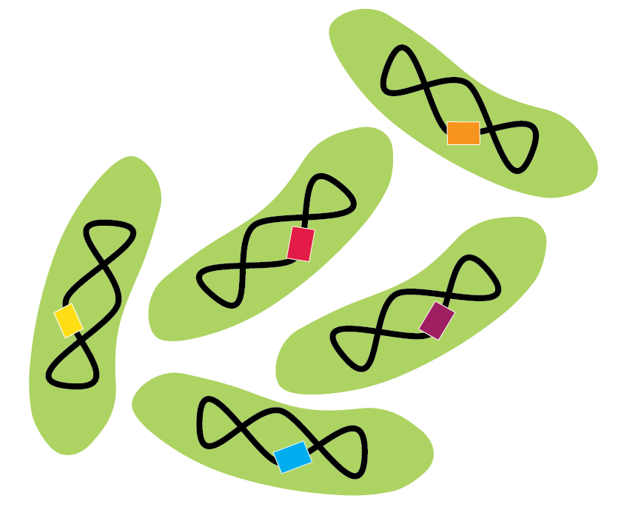
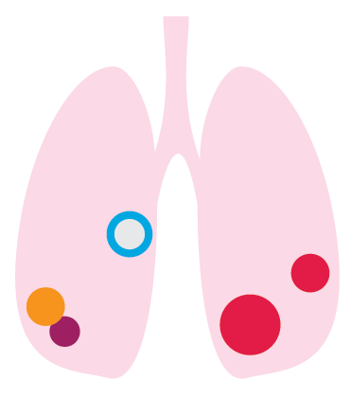
Each bacterium is
tagged with a
unique sequence identifier,
aka. ‘barcode’

Slide 12

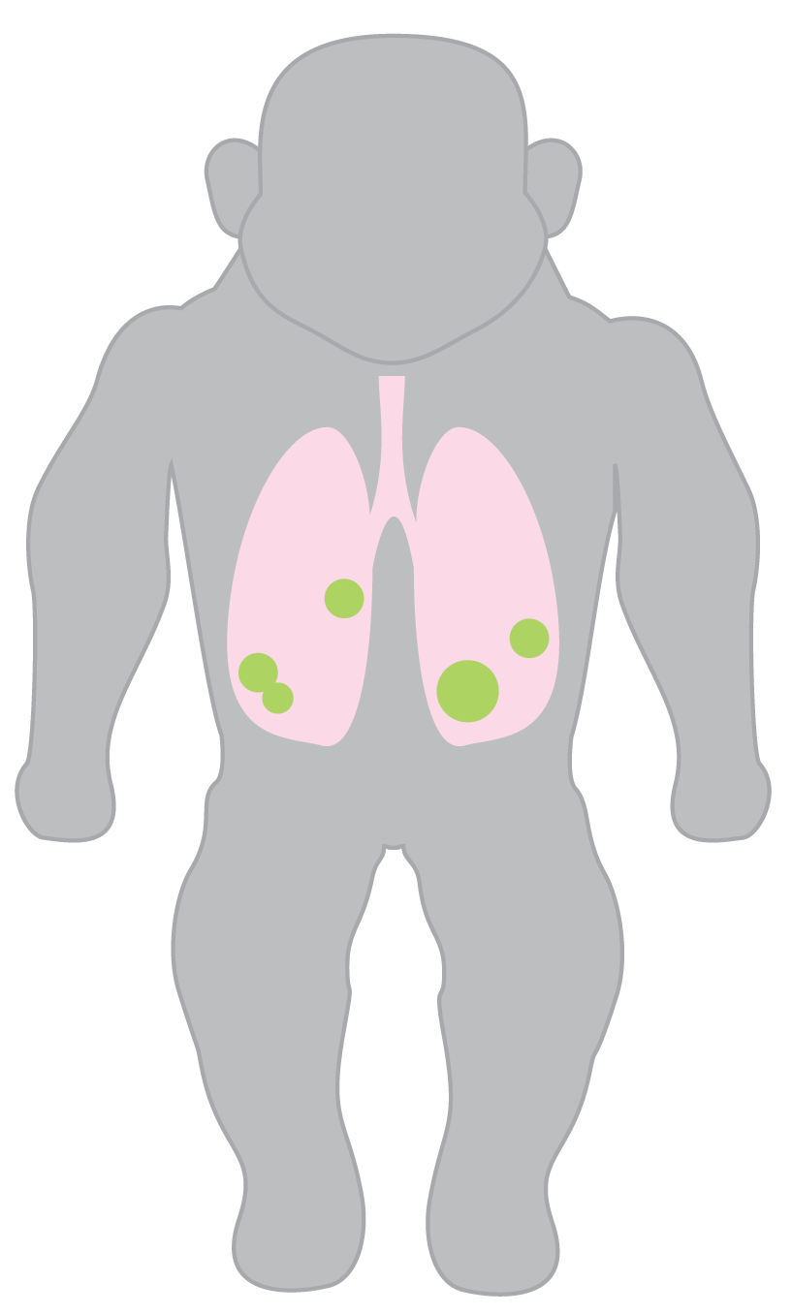
infect
isolate lesions
sequence
identify which bacteria were in each lesion

Slide 13
How do we identify barcodes?
How do we count them?

Slide 14
How do we identify barcodes?
How do we count them?

Slide 15
How do we identify barcodes?
You sequence the barcode, and read the sequence…
What is so hard??

Slide 16
What exactly is this ‘barcode’ ?

Slide 17

Genomic tag
a randomized 7mer

Slide 18

Q-tag
Class identifier that marks a barcode library
Each Q-tag class > 14,000 barcodes
To reliably select 100 unique bacteria (p < 0.01), we need 3 libraries

Slide 19
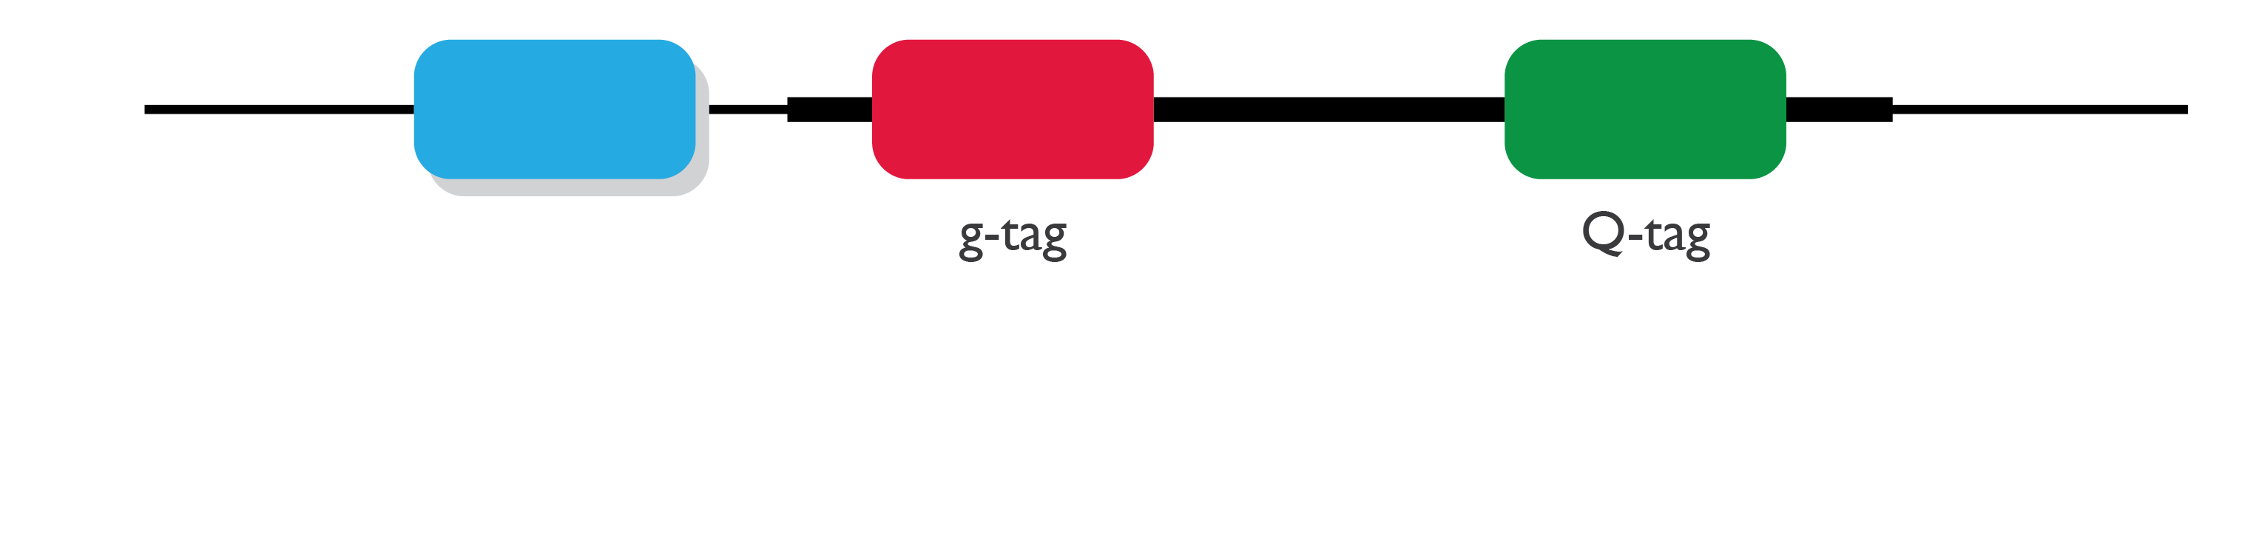
During library preparation…
Molecule Counter
a randomized 9-mer
can count templates instead of amplicons

Slide 20
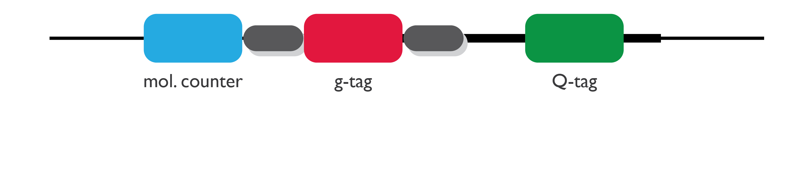
constant handles

Slide 21
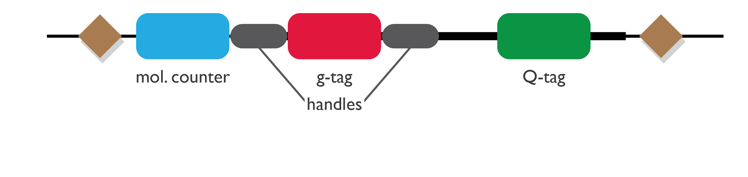
Jitter
variable-length region
reduces sequencing error

Slide 22
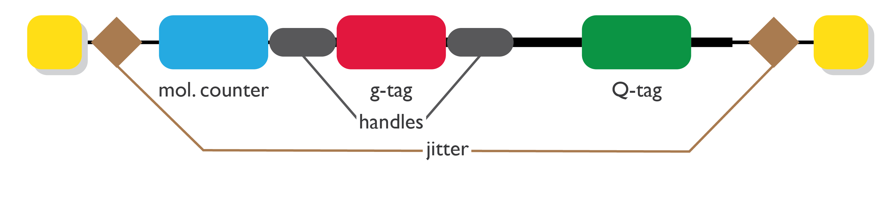
Index
ID for each sample

Slide 23
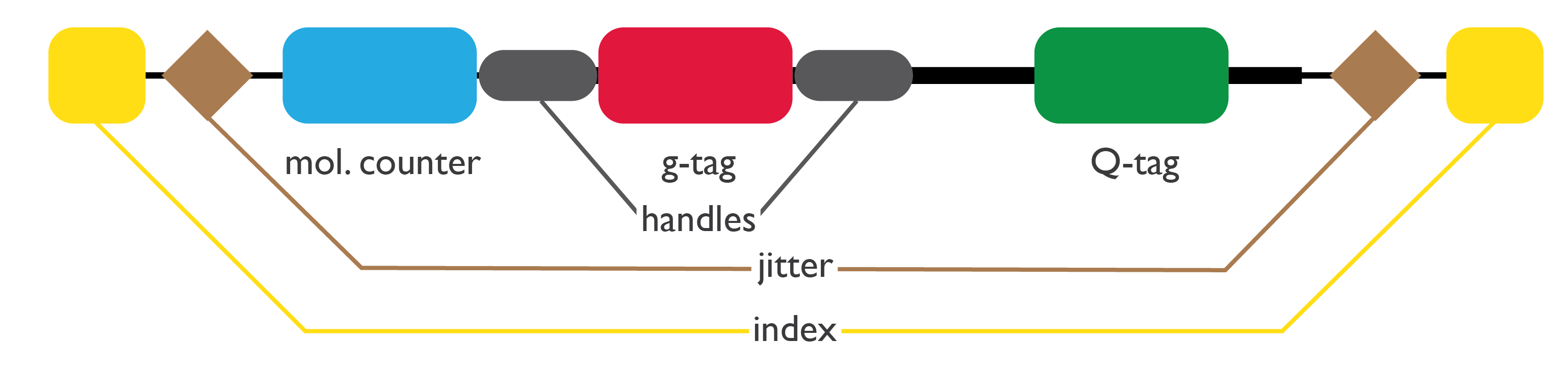
How do we identify barcodes?
You sequence the barcode, and read the sequence…
What is so hard??

Slide 24
the problem:
noise

Slide 25
The problem of noise
For example…
Pick 25 barcoded colonies
Sequence
Count Q-/g-tags (QGs)

Slide 26
“QG”
a unique Q-tag-g-tag combination

Slide 27

The problem of noise
In an ideal world…
reads for each QG
25
rank-ordered QGs

Slide 28
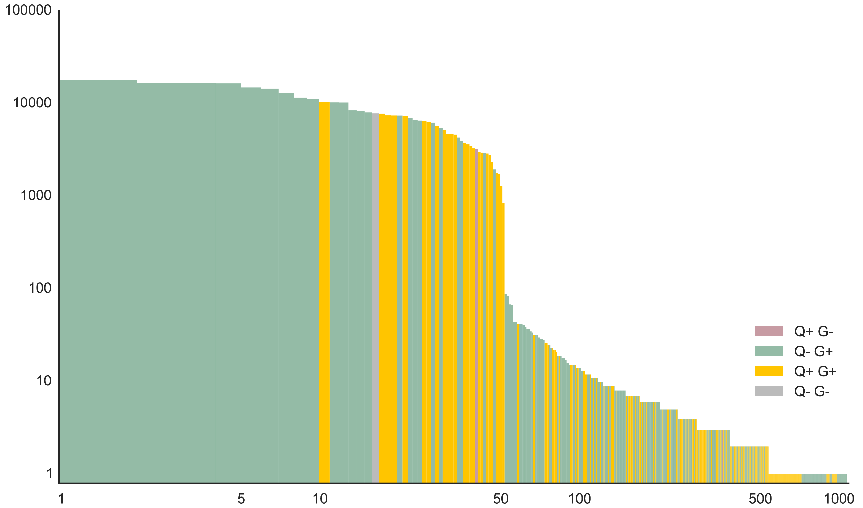
The problem of noise
In reality…
reads for each QG
rank-ordered QGs

Slide 29
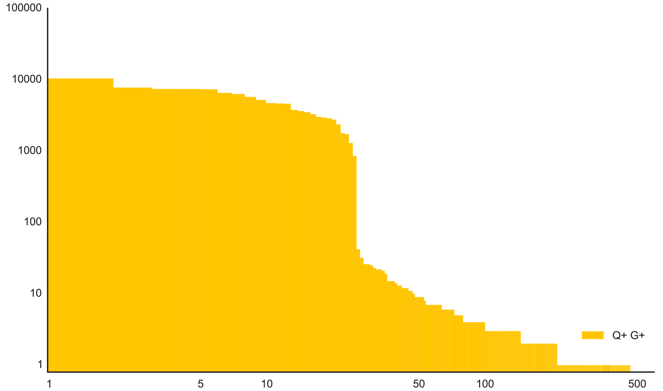
The problem of noise
In reality…
25 QGs
467 QGs
reads for each QG
rank-ordered QGs

Slide 30
The problem of noise
How do we distinguish true sequences
from erroneous ones?

Slide 31
Where does noise come from?
Sequencing error
Base-calling error
Spot-finding issues
Base bias
Amplification error
Contamination

Slide 32
Where does noise come from?
Sequencing error
Base-calling error
Spot-finding issues
Base bias
Amplification error
Contamination
Isolate each step of library preparation
Run negative controls with each library

Slide 33
Where does noise come from?
Sequencing error
Base-calling error
Spot-finding issues
Base bias
Amplification error
Contamination

Slide 34
Fortunately…

Slide 35

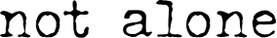
Image: The X-Files
Image: The X-Files

Slide 36
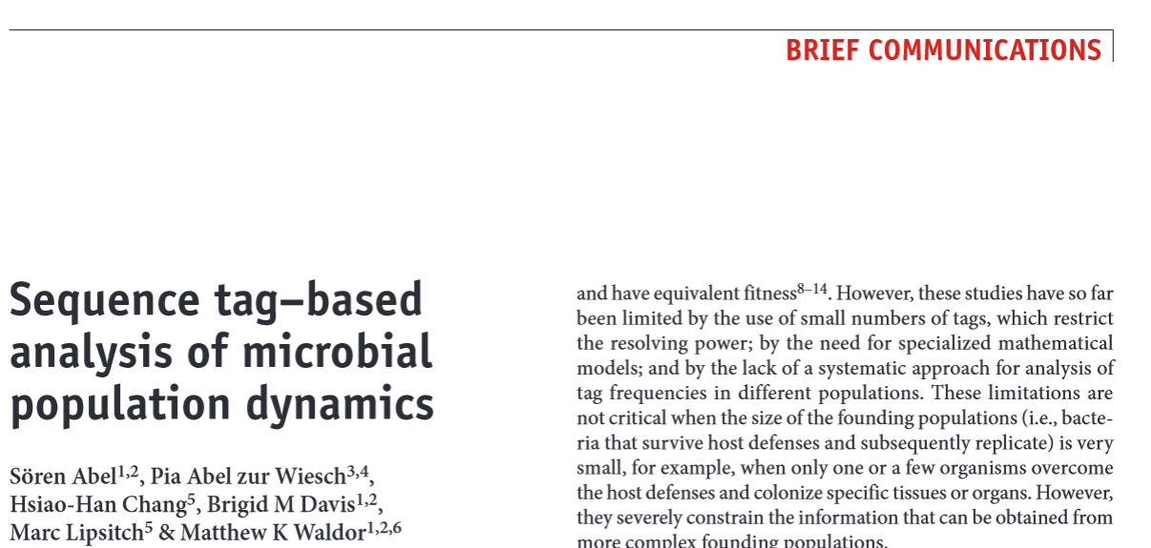


The noise problem is common

Slide 37
The noise problem is common
How did they deal with it?

Slide 38

2015
Infected with and counted only known barcodes (~500 known)
Low-throughput
Only see changes in population composition

Slide 39
NUCLEIC RES. PAPER

Slide 40
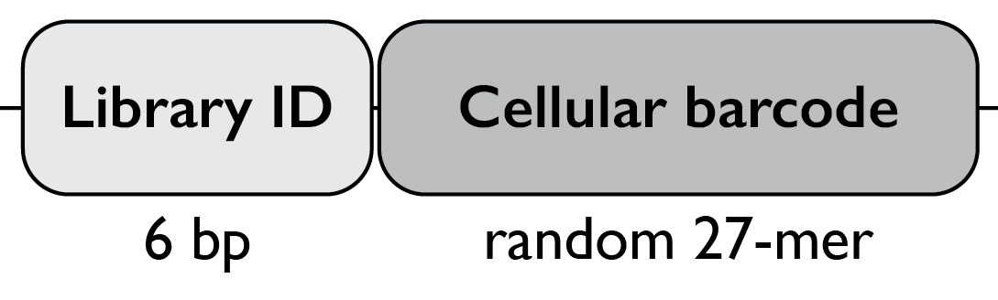
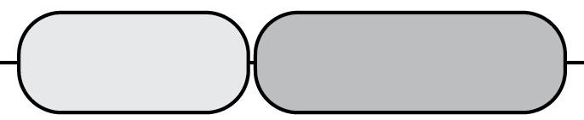
2011

Slide 41
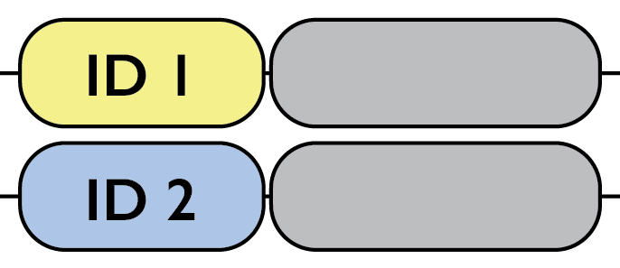
2011
Known
library IDs
Estimate background noise using ‘mock library IDs’
Combine ‘similar’ barcodes to preserve data

Slide 42
2011
Known
library IDs
Estimate background noise using ‘mock library IDs’
Combine ‘similar’ barcodes to preserve data

Slide 43

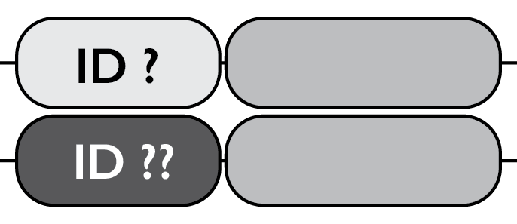
2011
Estimating background noise
Known
library IDs
Unidentifiable
library IDs

Slide 44
2011
Estimating background noise
Consider unidentifiable library IDs as ‘mock’ IDs
Count barcodes to estimate background noise
Use this as a quantitative threshold for ‘real’ reads
‘mock library IDs’
Unidentifiable
library IDs

Slide 45
2011
Estimating background noise
Consider unidentifiable library IDs as ‘mock’ IDs
Count barcodes to estimate background noise
Use this as a quantitative threshold for ‘real’ reads
‘mock library IDs’
Unidentifiable
library IDs
From where do these ‘mock’ IDs originate?
Is this an accurate and sensitive way to threshold data?…

Slide 46
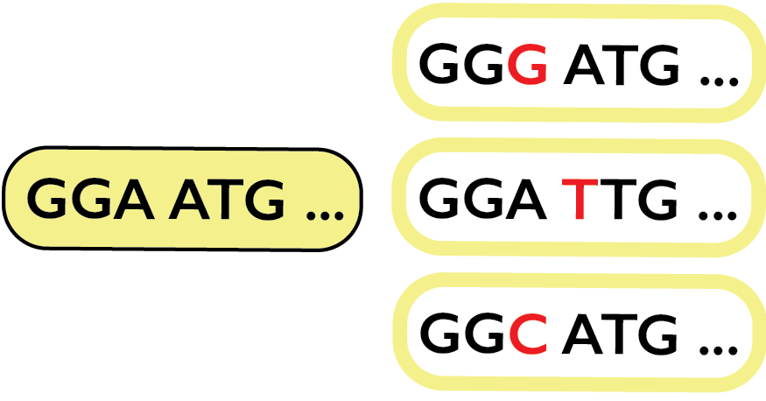
2011
Combining ‘similar’ barcodes to preserve data
error
unidentifiable but related library IDs
known library ID

Slide 47
2011
Combining ‘similar’ barcodes to preserve data
Treat these as all the same barcode
known library ID

Slide 48
So, what do we do?
What data can we believe?
How do we find the true barcodes?

Slide 49

Image: The X-Files

Slide 50
How do we identify barcodes?
How do we count them?

Slide 51
Identifying Barcodes
Step 1: Find barcode components

Slide 52
Identifying Barcodes
Step 1: Find barcode components
Read 1
Read 2
H
Q

Slide 53
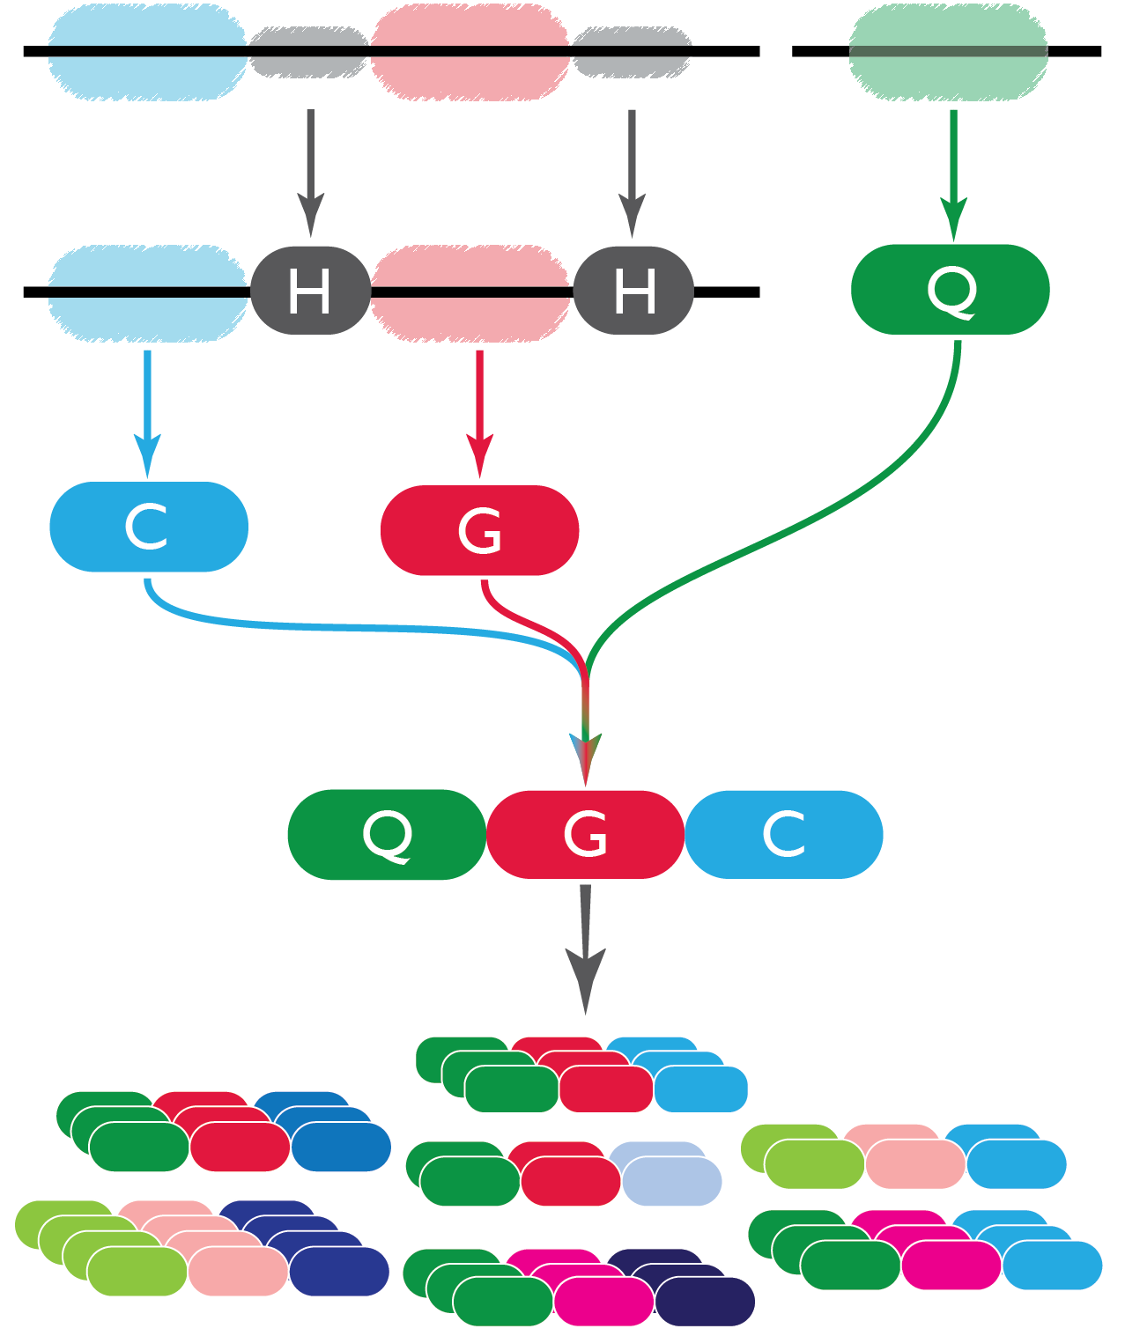
Identifying Barcodes
Step 1: Find barcode components
Read 1
Read 2
1.
Pair Reads 1 & 2.

Slide 54
Identifying Barcodes
Step 1: Find barcode components
Read 1
Read 2
1.
3.
2.
Pair Reads 1 & 2.
Find Q-tag on Read 2.
Find constant handles on Read 1.

Slide 55
Identifying Barcodes
Step 1: Find barcode components
Read 1
Read 2
1.
3.
2.
Pair Reads 1 & 2.
Find Q-tag on Read 2.
Find constant handles on Read 1.
Select molecular counter and g-tag based on handles.
4.

Slide 56
Identifying Barcodes
Step 1: Find barcode components
Read 1
Read 2
1.
3.
2.
Pair Reads 1 & 2.
Find Q-tag on Read 2.
Find constant handles on Read 1.
Select molecular counter and g-tag based on handles.
Bin QGC based on exact match.
4.
5.

Slide 57

How do we identify barcodes?
Step 2: Filter for quality
Pair Reads 1 & 2.
Find Q-tag.
Find constant handles.
Select g-tag and molecular counter based on handles.
Bin QGC based on exact match.
Filter so that every base in each read has a Quality Score > 30.
For each base, “is QS > 30?”
Case A.
························
All OK?
YES
KEEP
·············· ·········
Case B.
×
NO
DISCARD

Slide 58
How do we identify barcodes?
Step 2: Filter for quality
Pair Reads 1 & 2.
Find Q-tag.
Find constant handles.
Select g-tag and molecular counter based on handles.
Bin QGC based on exact match.
Filter so that every base in each read has a Quality Score > 30.
Filter out reads with mispaired GQs.

Slide 59
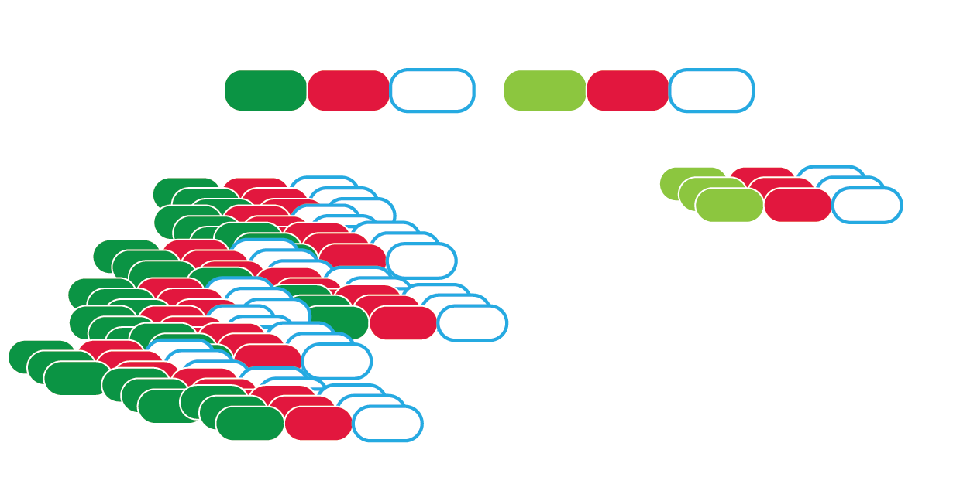
How do we identify barcodes?
Step 2: Filter for quality
“ 7. Filter out reads with mispaired GQs.. ”
Which is real?
Are they both real?

Slide 60
How do we identify barcodes?
Step 2: Filter for quality
“ 7. Filter out reads with mispaired GQs.. ”
Strategy:
Keep only the reads with the most abundant Q-tag
How effective is this strategy?

Slide 61
How do we identify barcodes?
Step 2: Filter for quality
“ 7. Filter out reads with mispaired GQs.. ”
What is the probability of drawing two bacteria with the same G-tag but different Q-tag?
If you put in 25 bacteria, probability is 0.8%.
BUT, if you put in 100 bacteria, probability increases is 12%.
This method is good for few barcodes, but not many. (There is a solution, which will be addressed later.)

Slide 62
If you have n=100 barcodes,
what is probability of having at least 1 pair with the same G-tag? (irrespective of same or different Qtag as they are subsets of G-tag.) as a loose upper bound.
P (>= 1 pair) = 1 - P(all unique) = 1 - 4^7!/(4^700*(4^7-100)!) = 26%
(1% for n=20 barcodes)
So, if you have few barcodes, it’s a good way to filter. Otherwise, you could be losing real data…
(Will address this later…)

Slide 63
find probability of have at least 1 pair with the same G-tag
What is the probability that that pair has the same Q-tag? Different Q-tags?
We only have 3 possible q-tags, so we will consider having two and three barcodes and qtags.
total possible ways to choose k barcodes for Q qtags = Q^k
(for 1 barcode: total ways = 3)
for 2 barcodes: total ways = 9
for 3 barcodes: total ways = 27
If we draw a qtag for each of the b barcodes, what’s the probability we get: (P = (n+k-1)!/(k!(n-k)!) = (b + 2)! / (b! (3-b)!)
P(1 Qtag)?
P(1Q|2B) =
P(1Q|3B) = (3 x 1 x 1) / 27 = 1/9
P (2 Qtags)?
P(2Q|2B) = (3 x 2) / 9 = 2/3
P(2Q|3B) = (3 x 2 x 2) / 27 = 4/9
P (3Qtags)?
P(3Q|3B) = (3 x 2 x 1) / 27 / 2 = 2 / 9 ==> max P(>1Q) is 4/9 x P(G) = 0.26 x 4/9 = 12%
If you have n=100 barcodes,
what is probability of having at least 1 pair with the same G-tag? (irrespective of same or different Qtag as they are subsets of G-tag.) as a loose upper bound.
P (>= 1 pair) = 1 - P(all unique) = 1 - 4^7!/(4^700*(4^7-100)!) = 26%
(1% for n=20 barcodes)
So, if you have few barcodes, it’s a good way to filter. Otherwise, you could be losing real data…

Slide 64
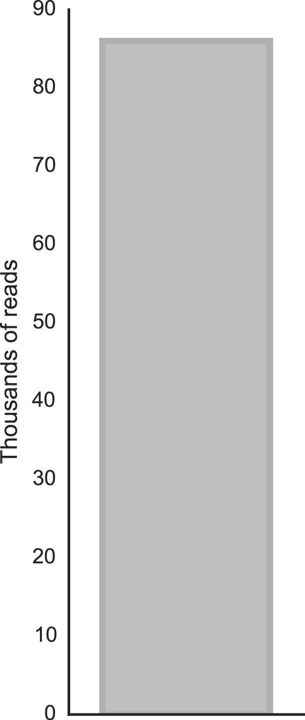
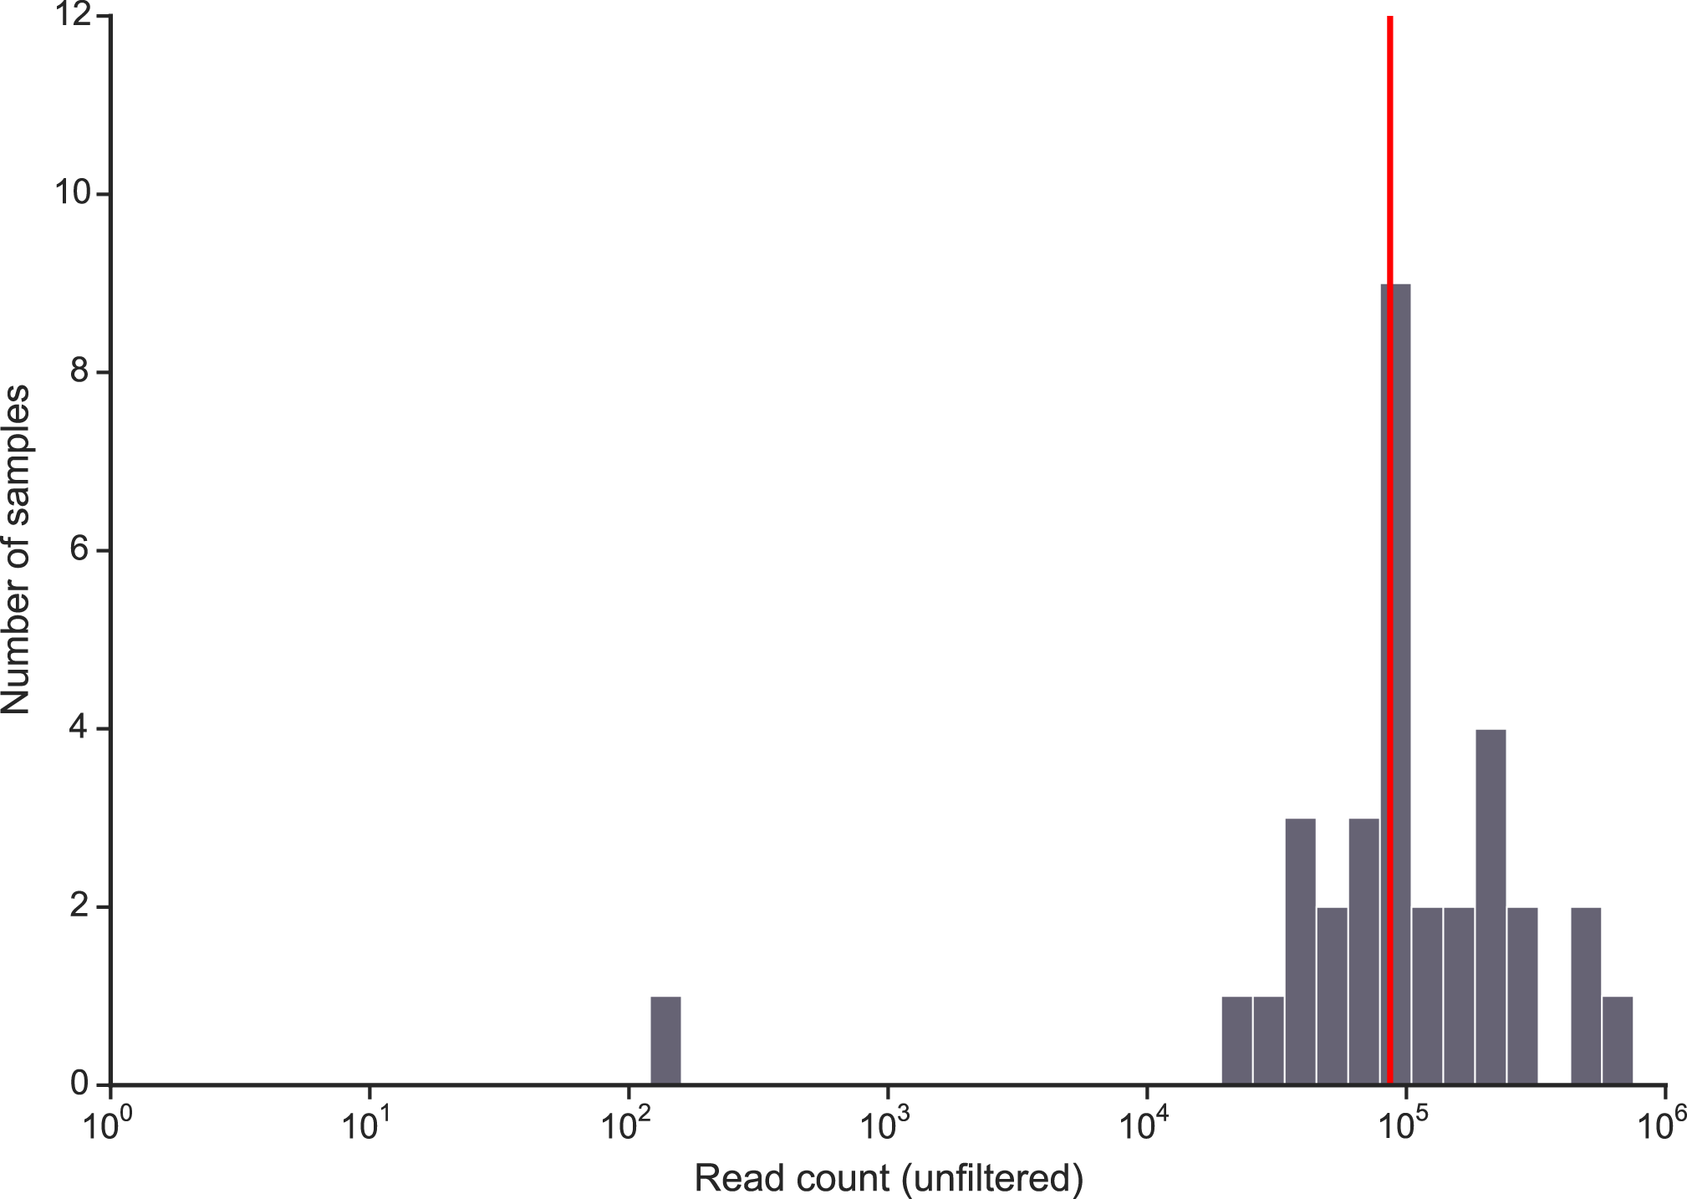
For a typical sample…
On average, about
100,000 raw reads

Slide 65
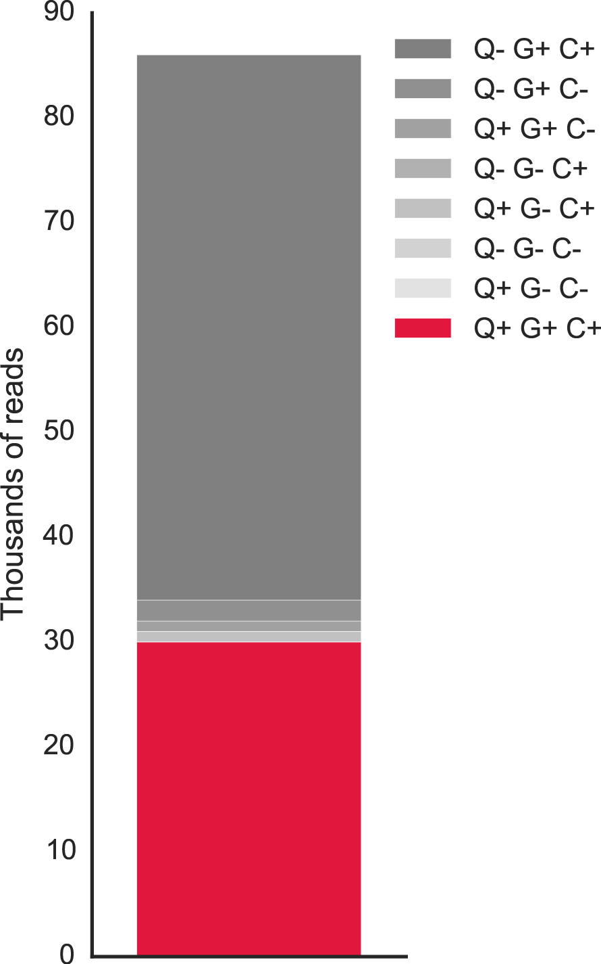
After Step 1 (Find barcode components)…
‘X+’ means read has X
‘X-’ means read DOES not have X
Q: Q-tag
G: G-tag
C: molecular Counter
Out of 100,000 reads,
30%
of reads remain.
These have a valid Q-tag, G-tag and molecular counter.

Slide 66
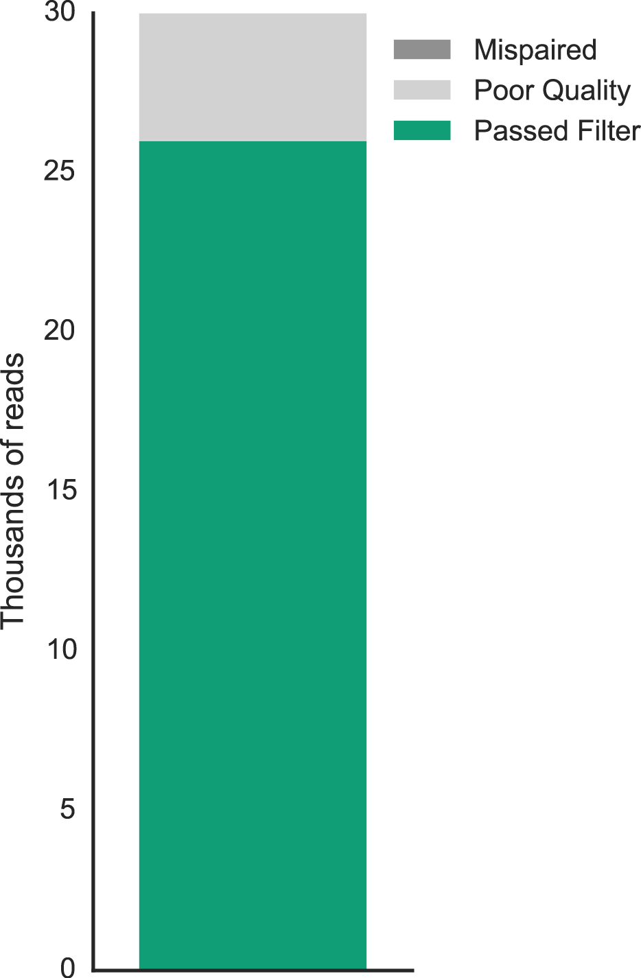
After Step 2 (Quality Filter)…
Have we solved the problem?

Slide 67
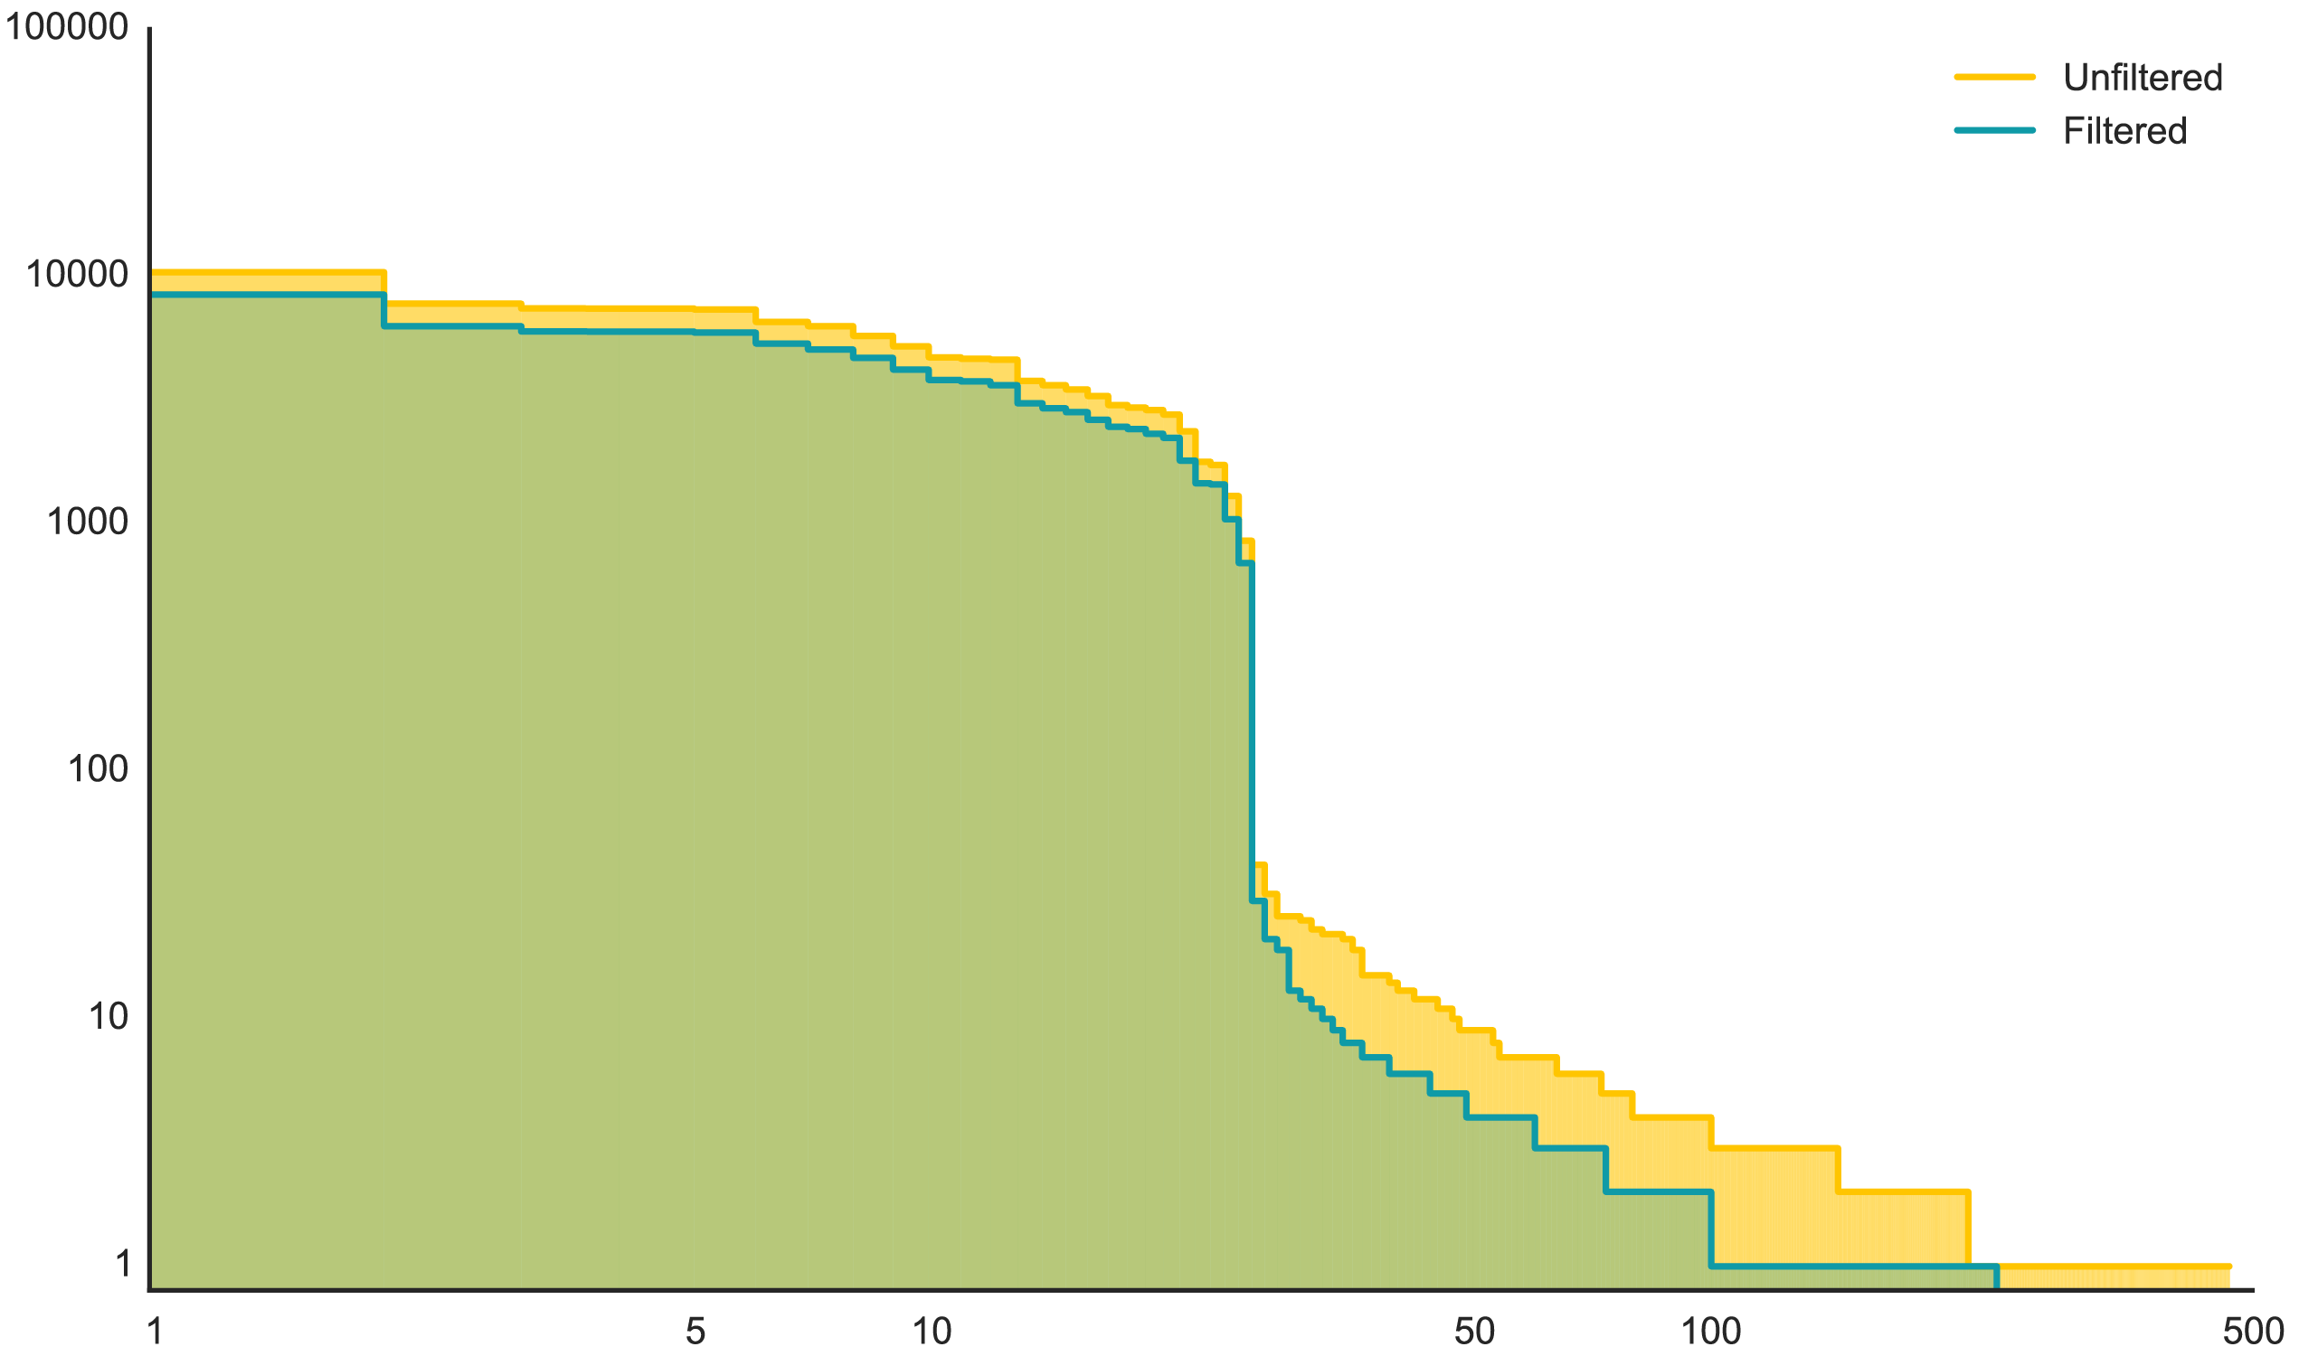
Have we solved the problem?
reads for each QG
rank-ordered QGs
Partially.
There is still the thresholding problem…

Slide 68
Fake barcodes are rare.
Not all rare barcodes are fake.
If there is no sequence metric for fake barcodes, can we threshold by relative abundance?

Slide 69
How do we identify barcodes?
How do we count them?

Slide 70
How do we count barcodes?
Idea 1: Weismann Method

Slide 71
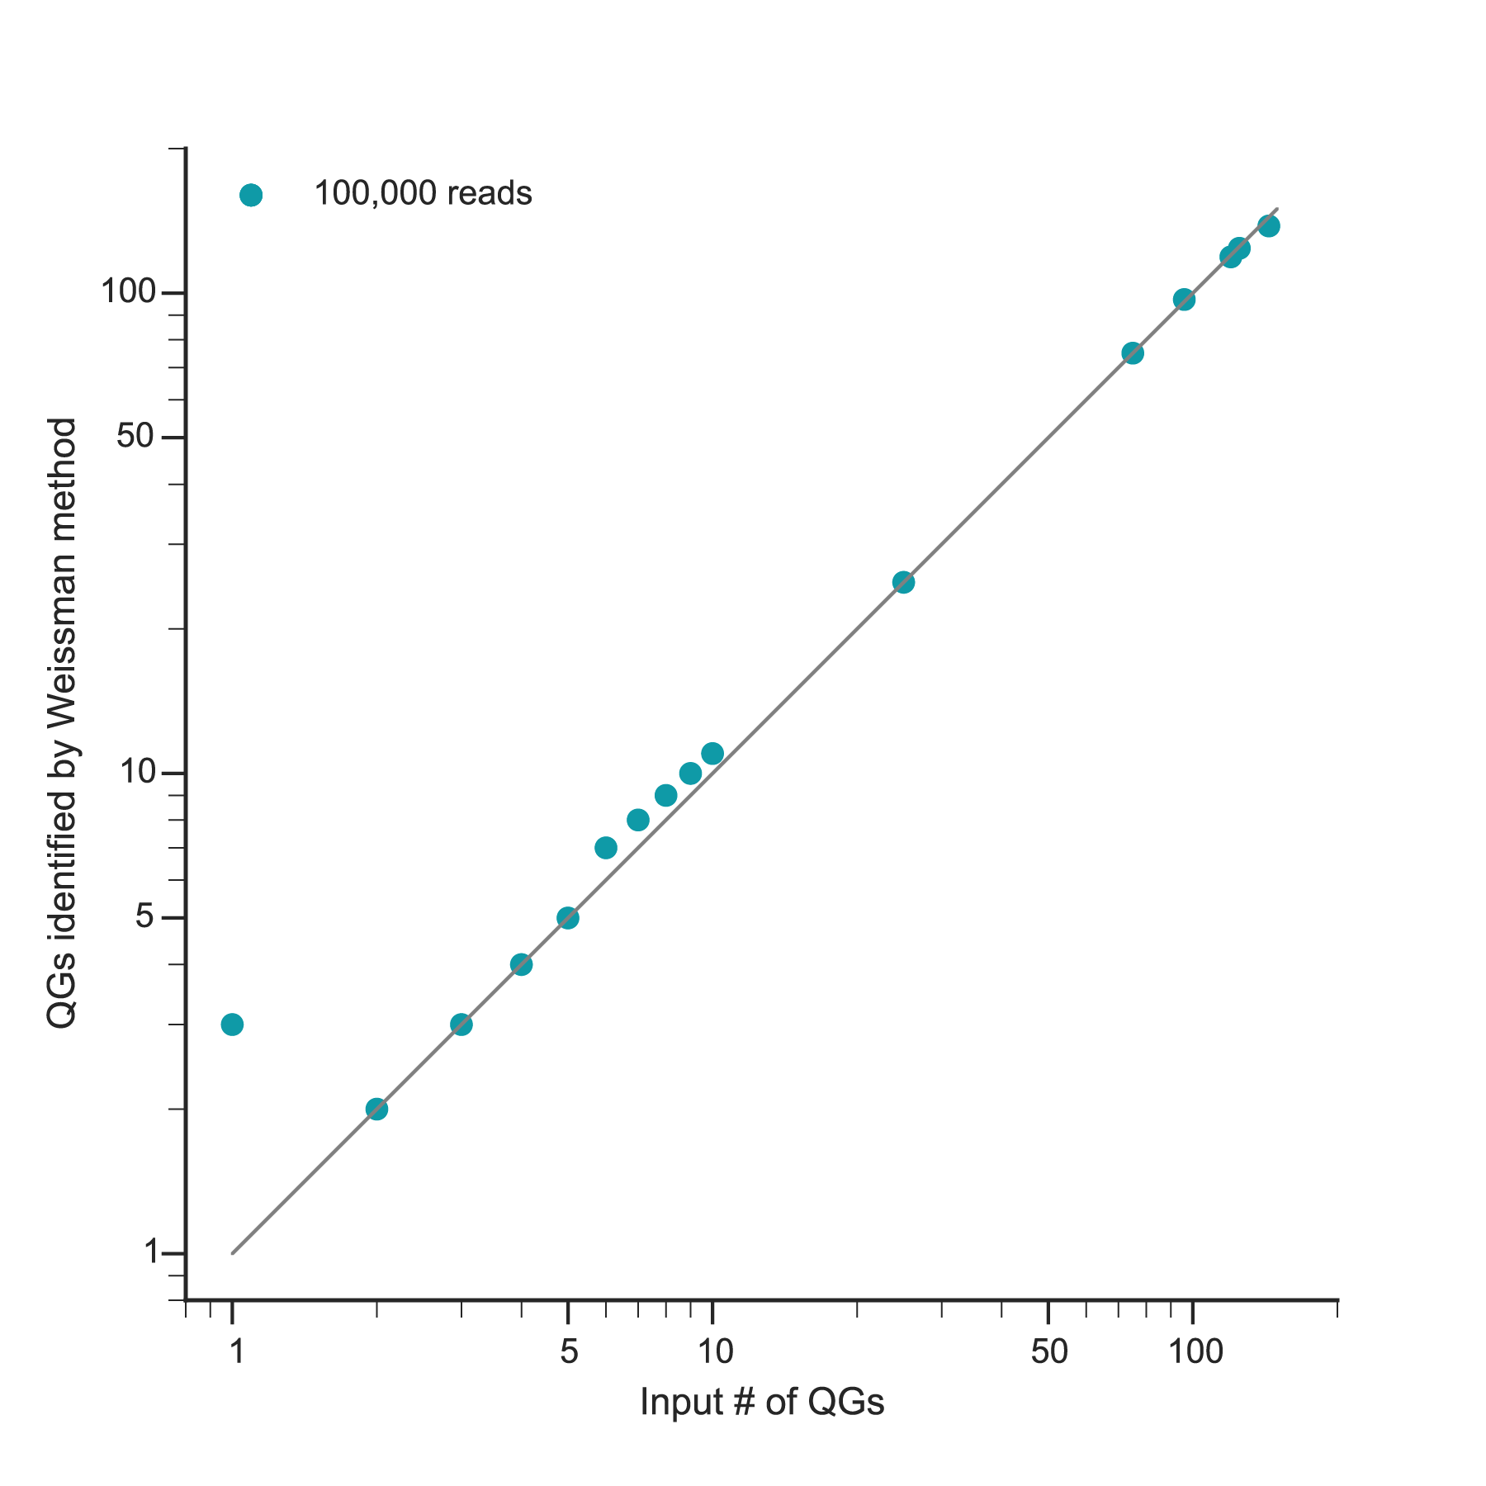
How do we count barcodes?
Idea 1: Weissman method
Pick X number of barcoded colonies.
Sequence.
Identify barcodes.
Threshold with Weissman method.
Compare input and identified # of QGs.
Not bad, but….

Slide 72
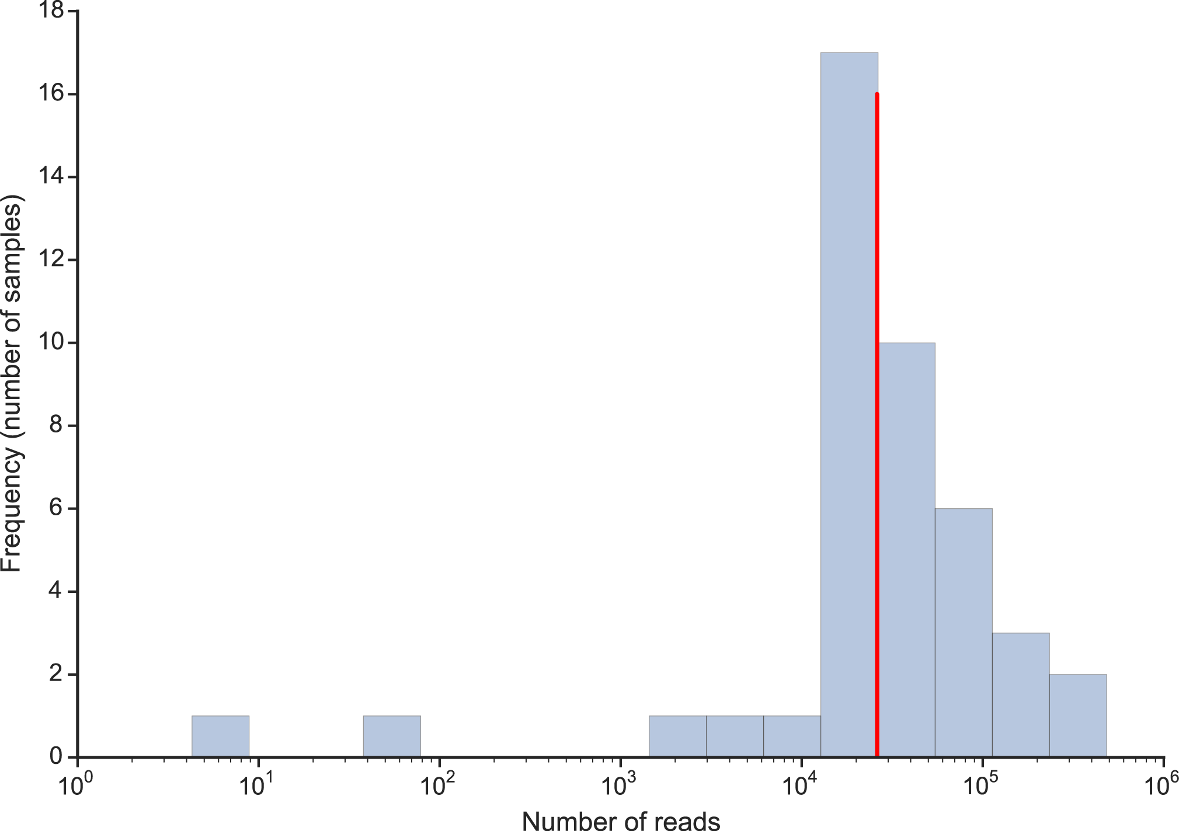
How do we count barcodes?
Idea 1: Weissman method
Median # reads after filter
26,000 reads

Slide 73
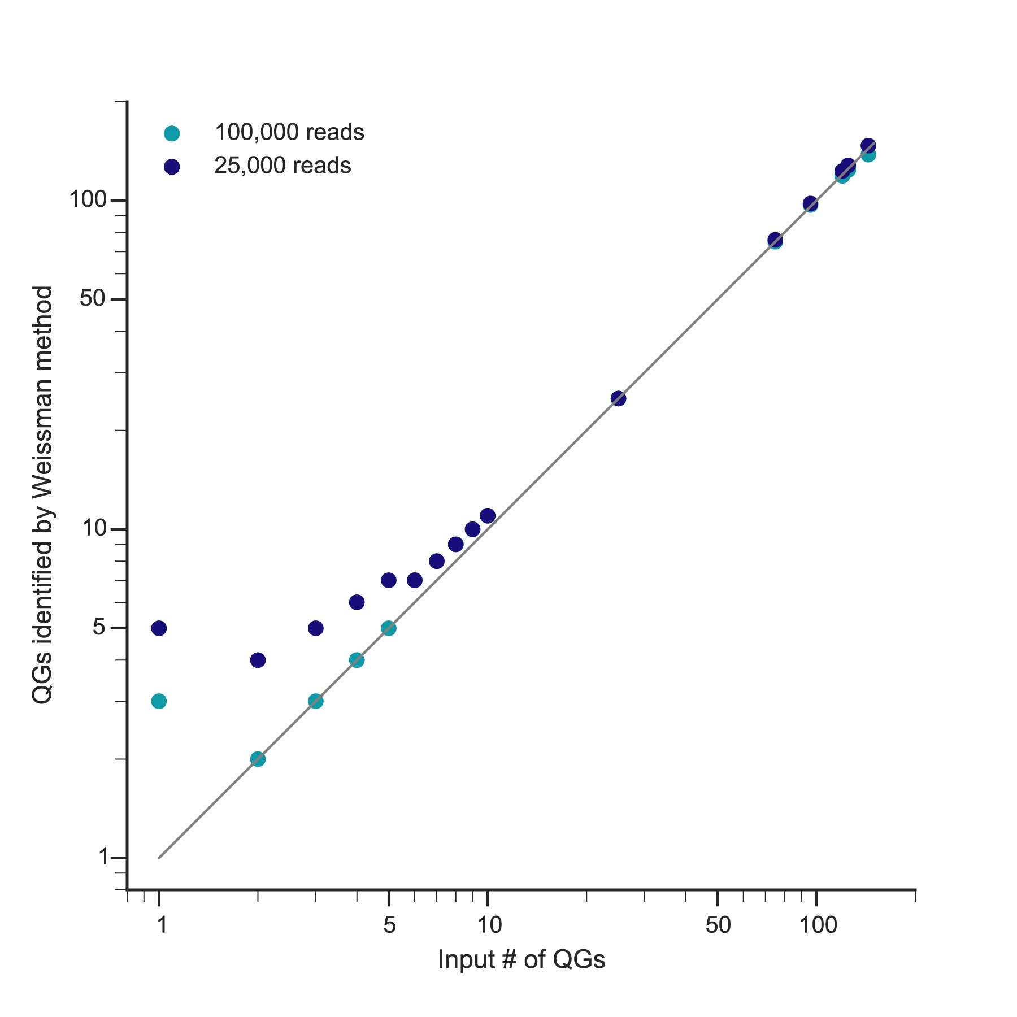
How do we count barcodes?
Idea 1: Weissman method
Bad resolution of low numbers of QGs

Slide 74
Why do we care about small numbers of barcodes?
In lesions, we see only a few initiating bacteria.
It’s important to distinguish 1 vs. 2 vs. 3 barcodes.

Slide 75
How do we count barcodes?
Idea 1: Weismann Method
Idea 2: Relative Abundance

Slide 76

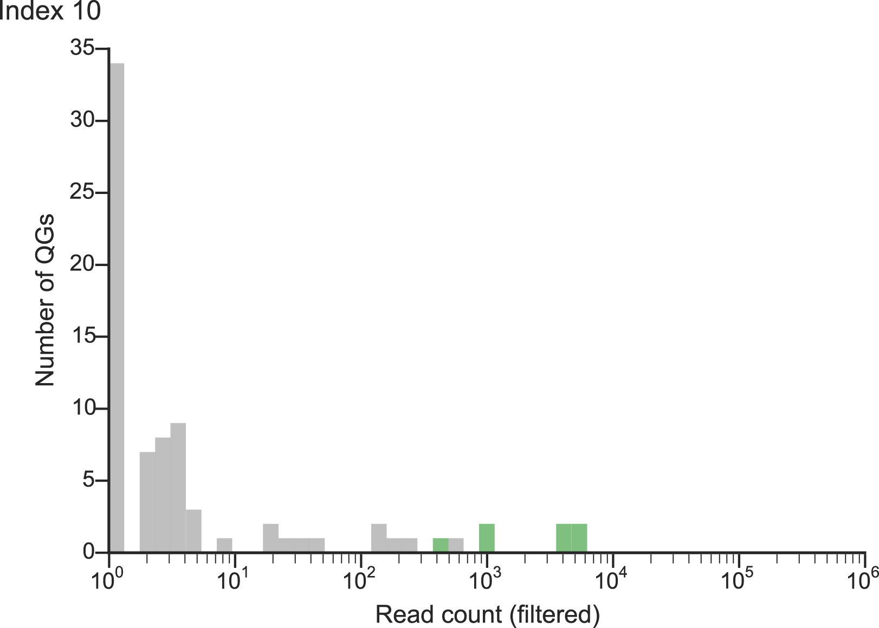
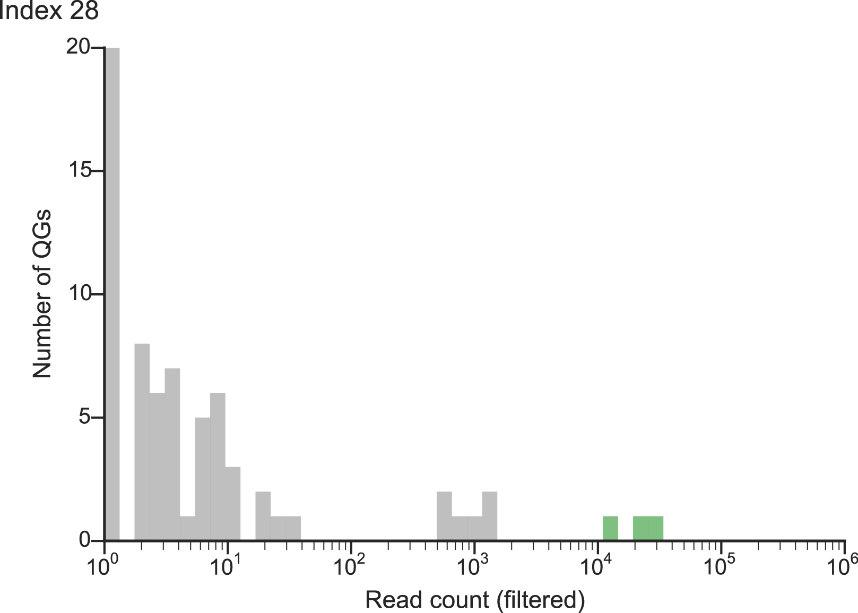
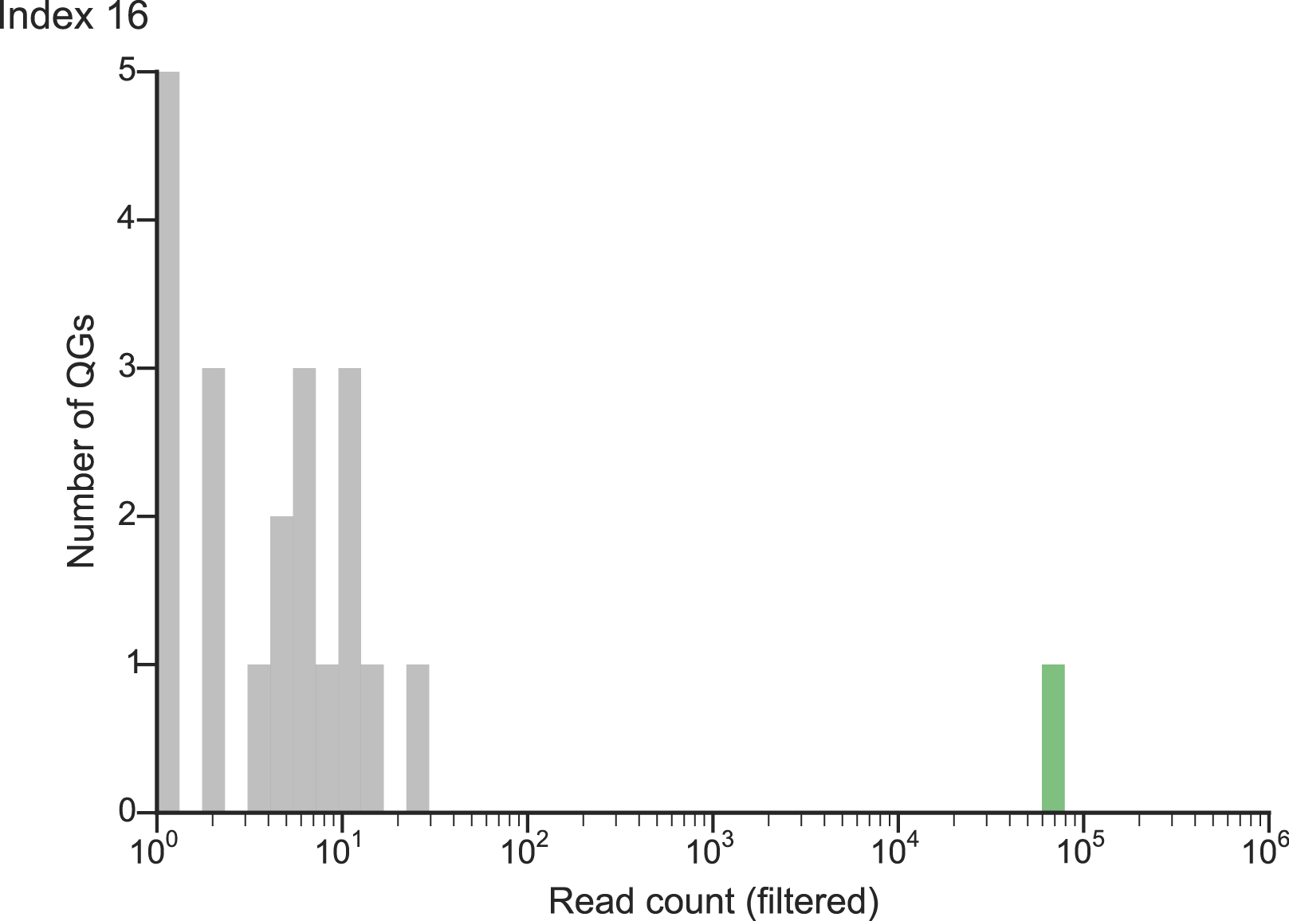
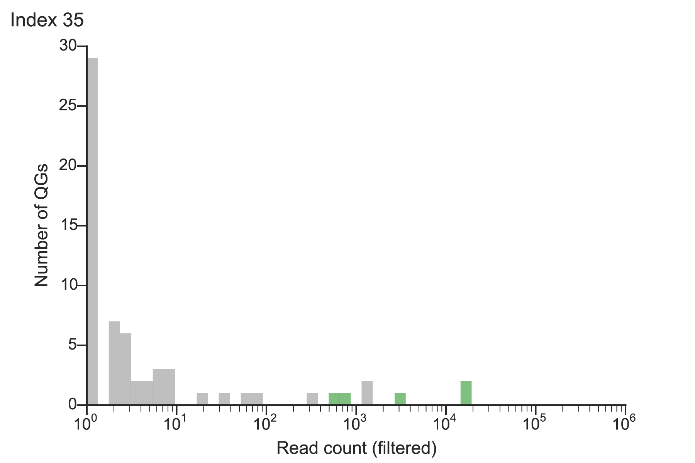
How do we count barcodes?
Idea 2: Relative abundance
Considering all samples, we see a segregation of real QGs and noise.

Slide 77
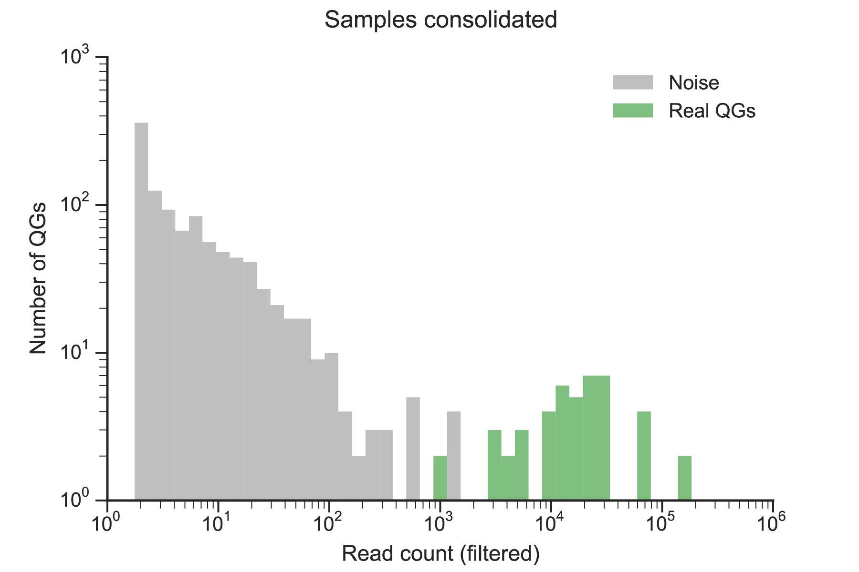


How do we count barcodes?
Idea 2: Relative abundance
Considering all samples, we see a segregation of real QGs and noise.
these are
noise
these are
real

Slide 78

How do we count barcodes?
Idea 2: Relative abundance
Considering all samples, we see a segregation of real QGs and noise.
these are
noise
what are these??
these are
real

Slide 79
How do we count barcodes?
Idea 1: Weismann Method
Idea 2: Relative Abundance
Idea 3: Standard Curve

Slide 80
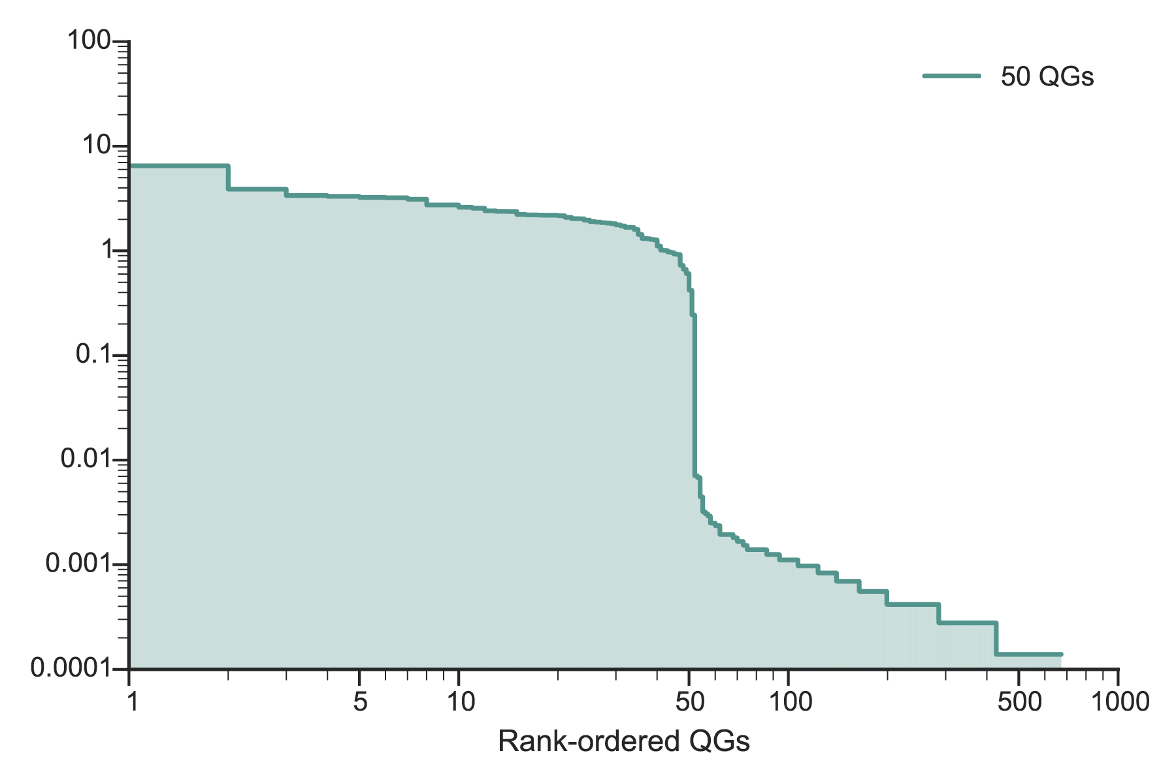
How do we count barcodes?
Idea 3: Standard curve
Pick 50 barcoded colonies,
sequence,
filter and identify QGs….
50 barcodes here
% of molecule counters
Rank-ordered QGs

Slide 81
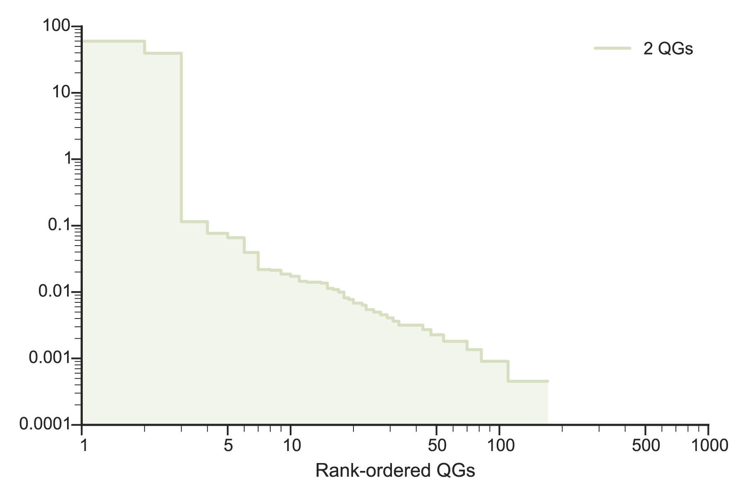
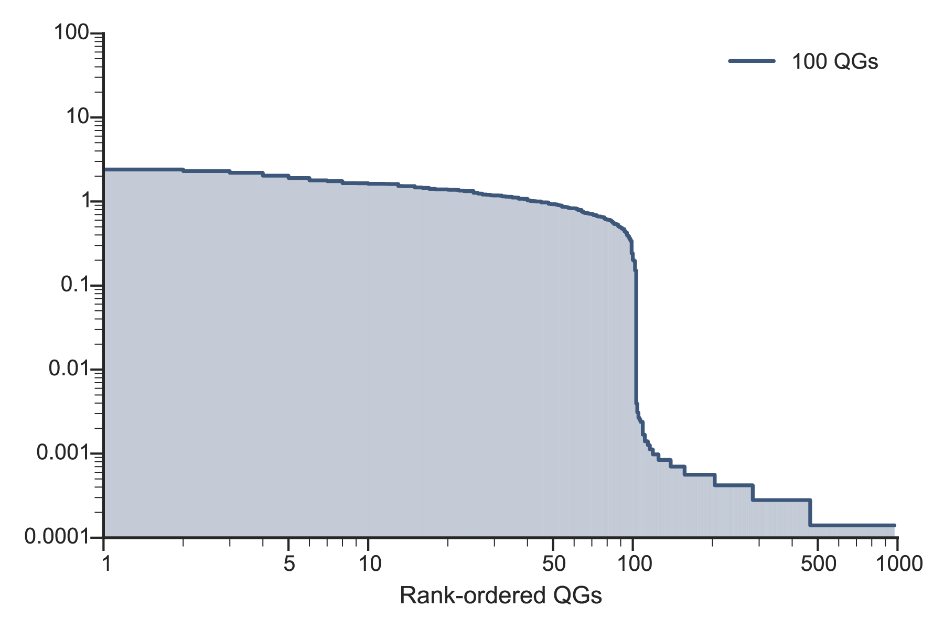
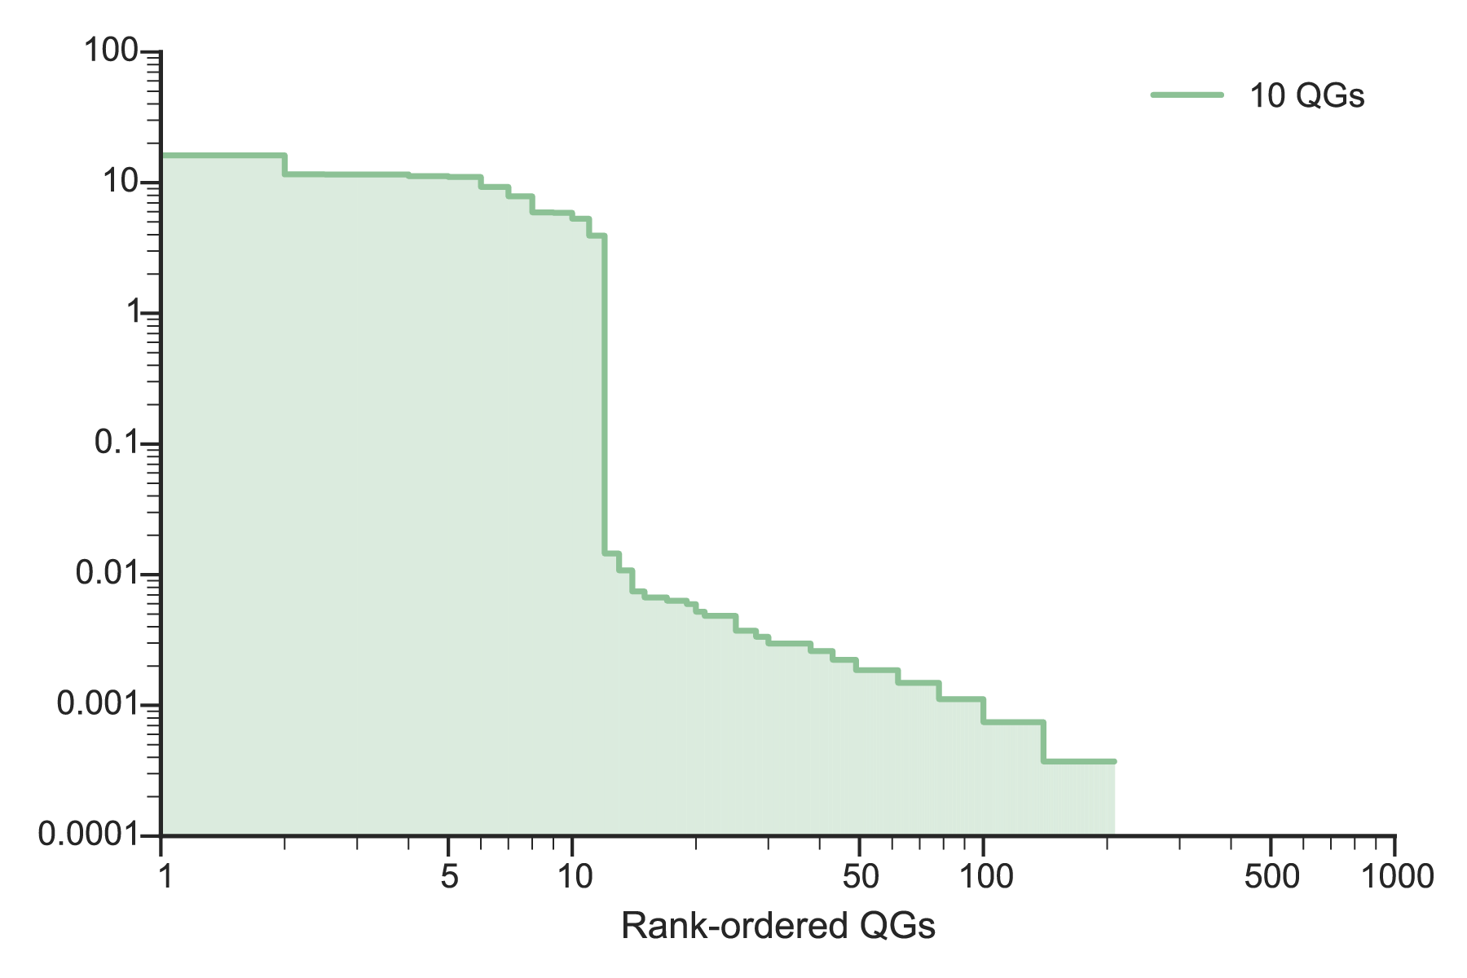
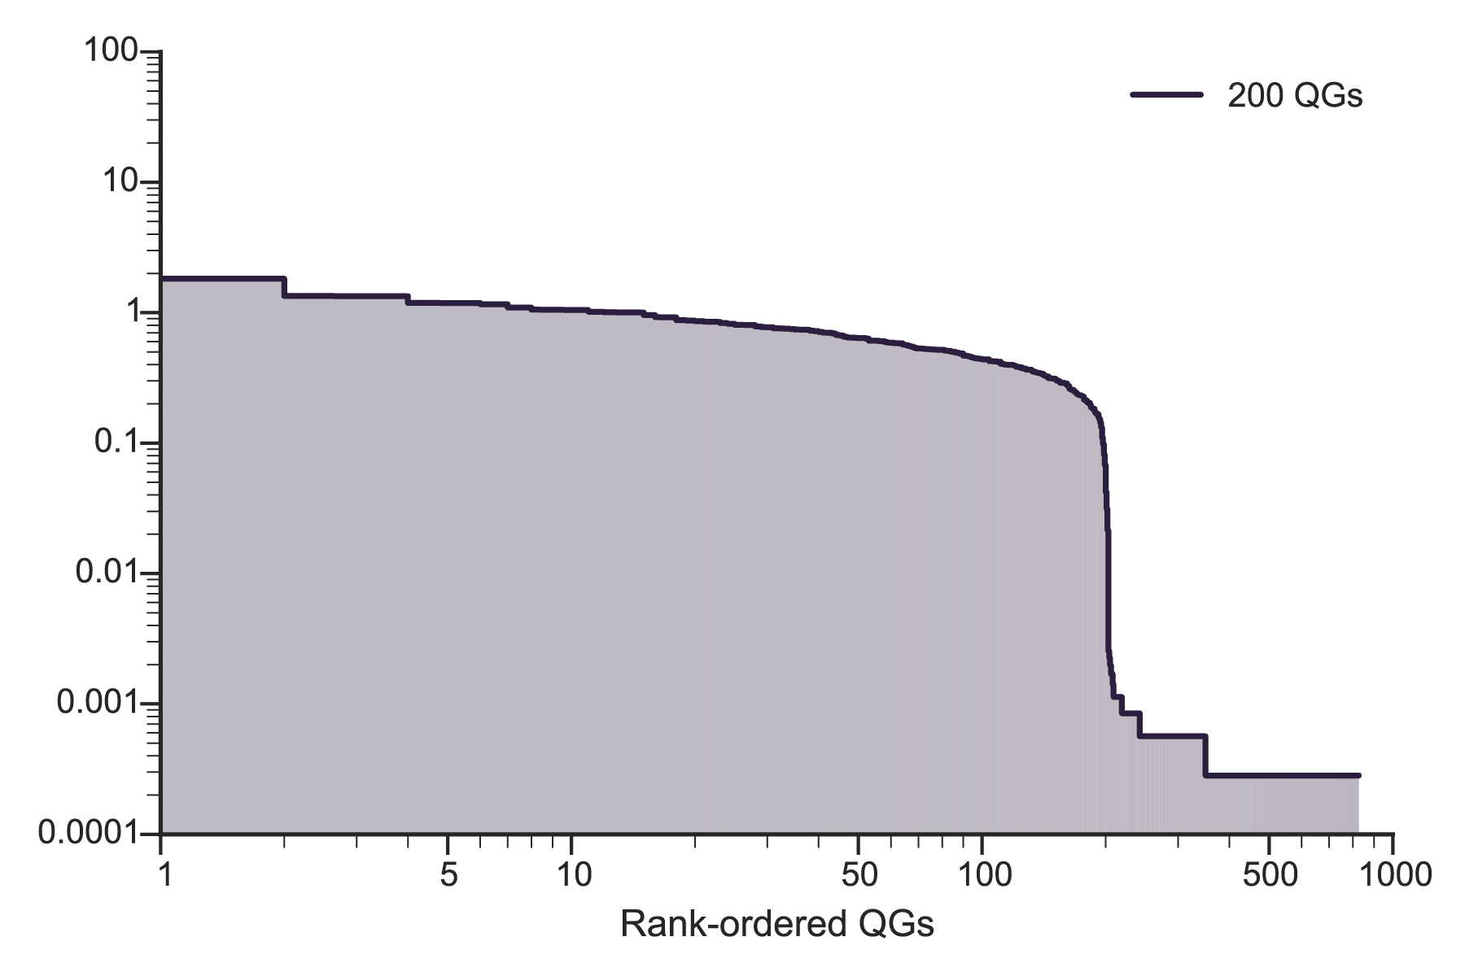
How do we count barcodes?
Idea 3: Standard curve
Do the same with 2, 10, 100, 200 barcodes…

Slide 82
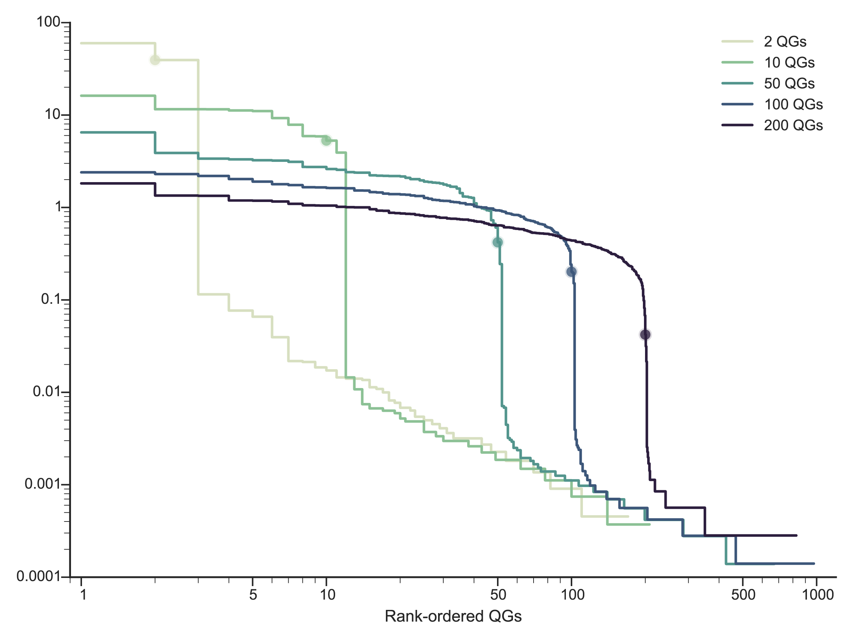
How do we count barcodes?
Idea 3: Standard curve
2nd QG
10th QG
50th QG
100th QG
200th QG

Slide 83
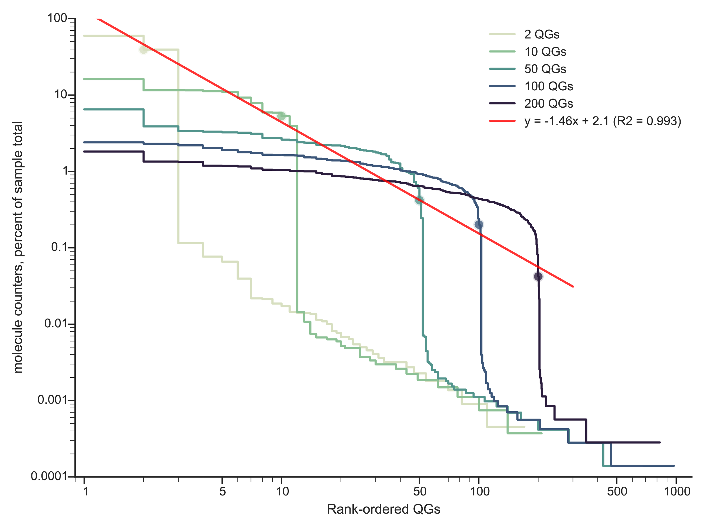
How do we count barcodes?
Idea 3: Standard curve
Strategy
Find last intersection point

Slide 84
How do we count barcodes?
Idea 3: Standard curve
QGs IN | QGs OUT | Difference
1 | 0 | 1
2 | 0 | 2
3 | 4 | -1
4 | 0 | 4
5 | 5 | 0
6 | 0 | 6
7 | 9 | -2
8 | 8 | 0
9 | 11 | -2
10 | 11 | -1
25 | 24 | 1
75 | 76 | -1
96 | 97 | -1
120 | 121 | -1
125 | 127 | -2
144 | 148 | -4
Picked X number of colonies.
Sequence and filter results.
Use standard curve to threshold data.
Not bad either,
but doesn’t handle 1 and 2 QGs,
and a pain…

Slide 85
How do we count barcodes?
Idea 1: Weismann Method
Idea 2: Relative Abundance
Idea 3: Standard Curve
Idea 4: Drop-off Point

Slide 86
How do we count barcodes?
Idea 4: Drop-off point
If we consider that barcodes belong to one of two distinct populations:
real and noise

Slide 87
How do we count barcodes?
Idea 4: Drop-off point
2nd QG
10th QG
Notice that threshold should be where the slope is most negative (“cliff” or “drop-off”).
50th QG
100th QG
200th QG
Strategy: Find this point of maximally negative slope.

Slide 88
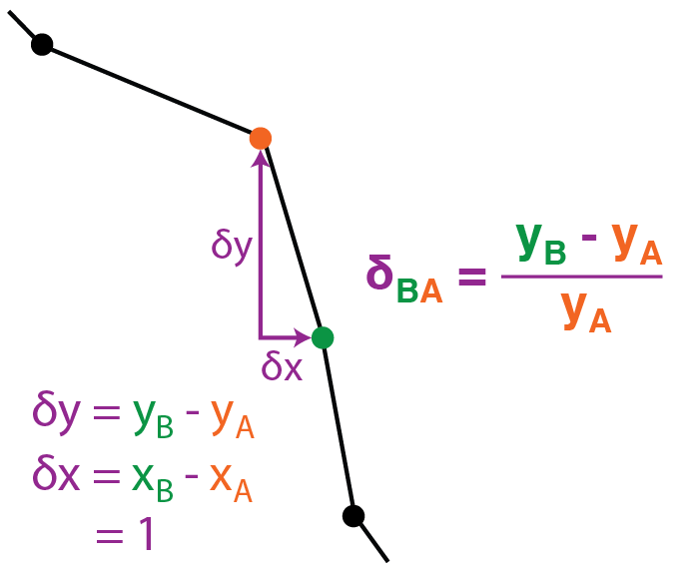
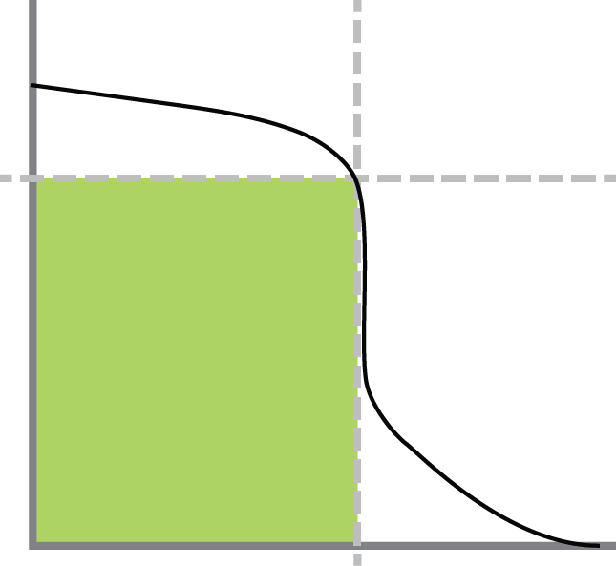


How do we count barcodes?
Idea 4: Drop-off point
Picked X number of colonies.
Sequence and filter results.
Use drop-off point to threshold data.
max (-δ)

Slide 89
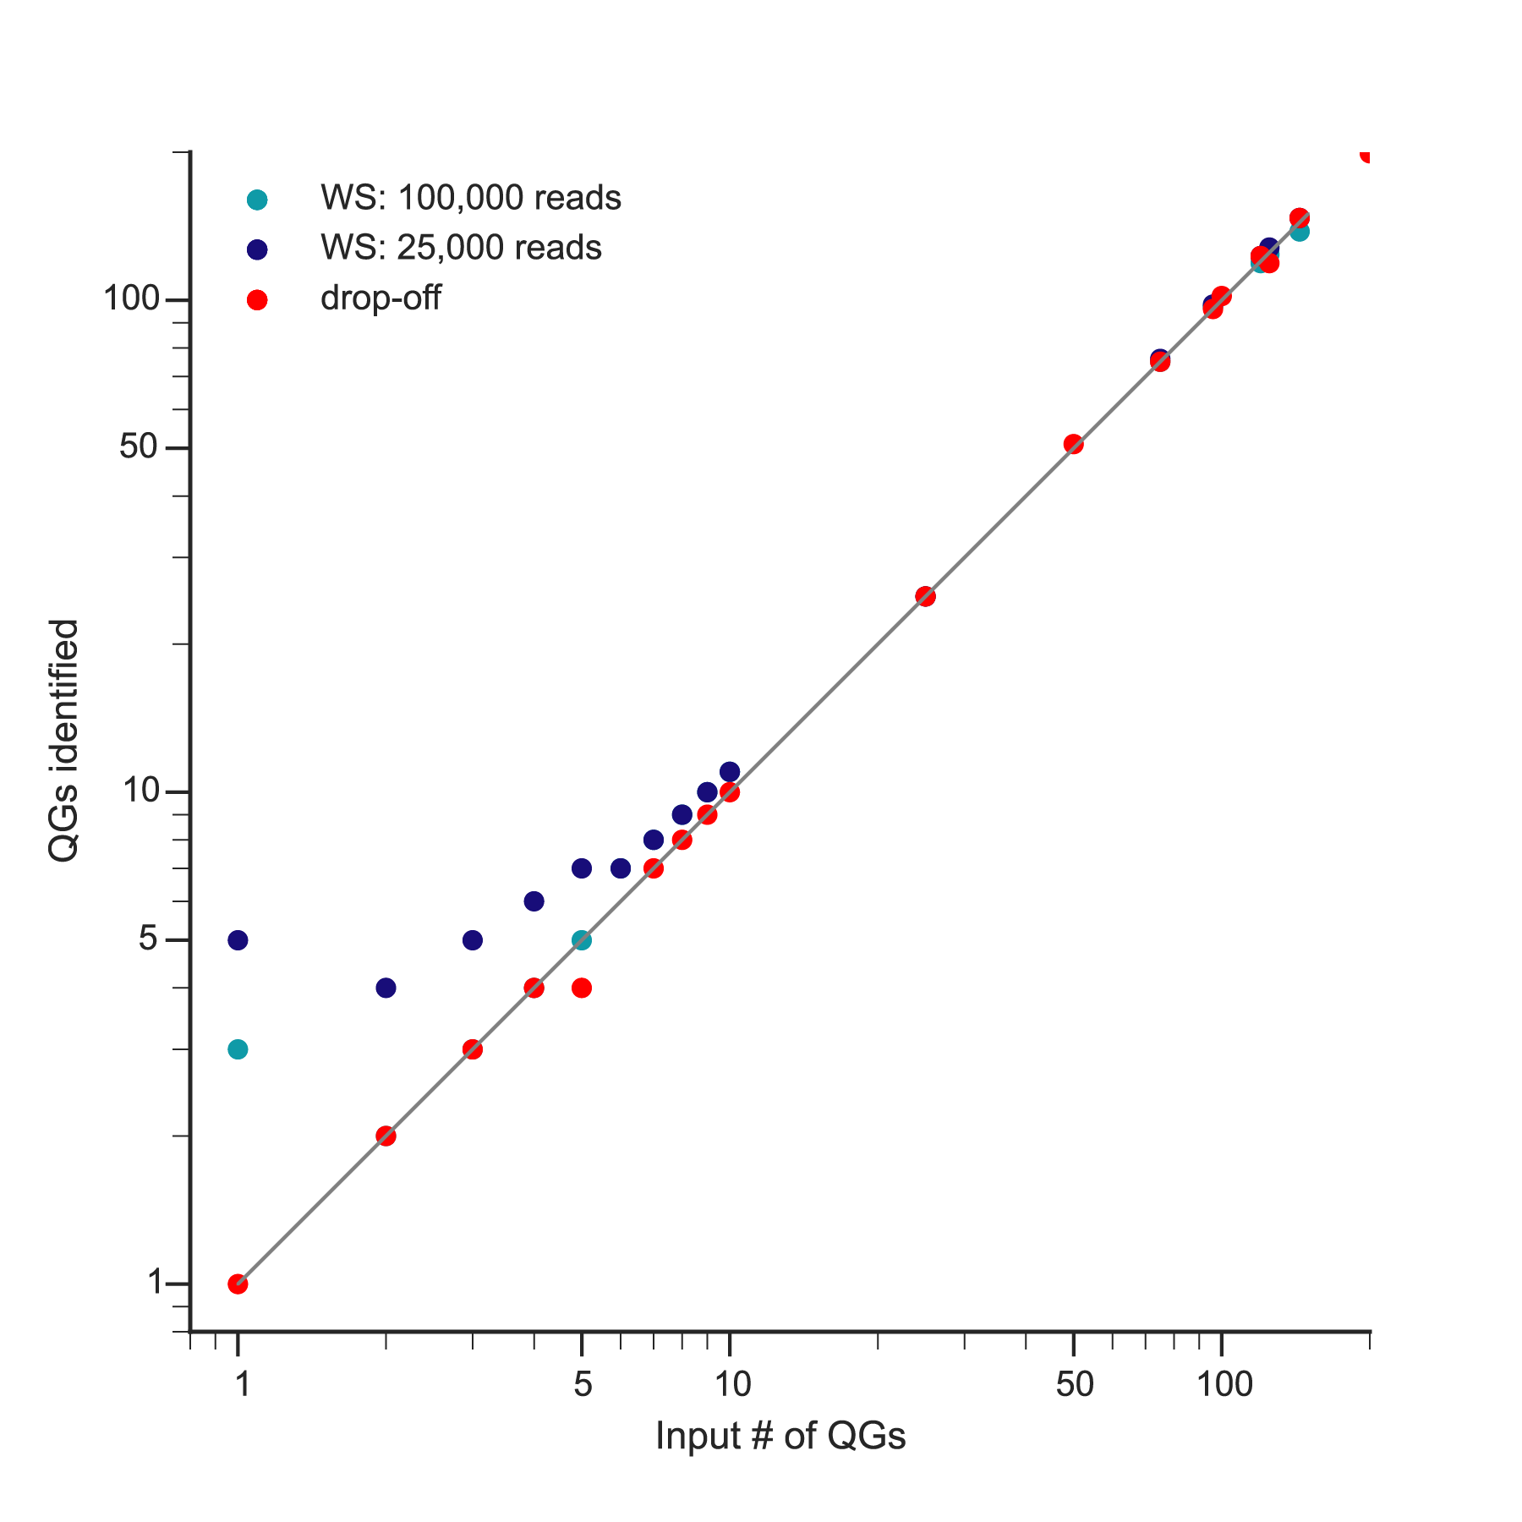
How do we count barcodes?
Idea 4: Drop-off point
QGs IN | QGs OUT | Diff
1 | 1 | 0
2 | 2 | 0
3 | 3 | 0
4 | 4 | 0
5 | 4 | 1
7 | 7 | 0
8 | 8 | 0
9 | 9 | 0
10 | 11 | -1
25 | 25 | 0
50 | 51 | -1
75 | 75 | 0
96 | 98 | -2
100 | 102 | -2
120 | 123 | -3
125 | 128 | -3
144 | 147 | -3
200 | 202 | -2

Slide 90
AWESOME…

Slide 91
AWESOME…
But let’s try mixing it up a bit….

Slide 92

% molecular counters
% molecular counters
rank-ordered QGs
rank-ordered QGs
What if we mixed: +
4 QGs at 22.5%
1 QG at 10%

Slide 93


Mixing it up a bit…
5 QGs at 20%
4 QGs at 22.5% plus 1 QG at 10%
5 QGs
25 QGs
% molecular counters
rank-ordered QGs

Slide 94
How do we deal with uneven abundance?

Slide 95
Recall a source of noise
error
If we can minimize noise
from sequencing error (‘one-off’s) perhaps we can detect low-abundance barcodes….

Slide 96
Dealing with uneven abundance…

Slide 97
Dealing with uneven abundance…
max (-δ)
Find drop-off threshold

Slide 98
Dealing with uneven abundance…
max (-δ)
Find drop-off threshold
ID ‘one-off’ QGs

Slide 99
Dealing with uneven abundance…
max (-δ)
Find drop-off threshold
Eliminate ID’ed noise
ID ‘one-off’ QGs

Slide 100
Dealing with uneven abundance…
max (-δ)
Find drop-off threshold
Yes (continue)
Any barcodes pass threshold?
Did threshold change?
Eliminate ID’ed noise
No changes
ID ‘one-off’ QGs

Slide 101
Dealing with uneven abundance…
RATIO | # QGs
60:40 | 2
90:10 | 2
95:5 | 3
99:1 | 1
99.1:0.1 | 1
90:10 | 2
** PRELIMINARY RESULTS…..

Slide 102
Counting barcodes with BARTi
can deal with low read counts
can identify low abundance barcodes (up to 1%)
unsupervised method (doesn’t require standard curves, estimating error rate)
Pretty good at conserving ratios

Slide 103
FUTURE DIRECTIONS
more validation with real data (scrapates, homogenates)
ways to validate
how to deal with 0 vs 1 QG
look closer at ratios — how to conserve or account for skewing?
(Look at clustering algorithms)

Slide 104
THANK YOU!
Alex
Allison
Bryan
Connie
Eli
Forrest
James
Jemila
Jeremy
Lenette
Mike
Nate
Sarah
Thibault

Slide 105


